Slide 1
THG Simulations
Project update
Week 5
18/08/2023
David Amorim

Slide 2
Simulations
An extensive round of parameter scans was carried out, involving over 5000 simulation runs and the following parameters:
gases: Ar, Ne, Kr, Xe, He, N2, and N2O
beam powers: 75mW, 150mW, 200mW, 300mW, and 400mW
pressures: 0.1bar to 5.1bar in 0.1bar increments
density profiles: gradient and COMSOL
The scan outputs consisted of:
total UV energy & efficiency
UV pulse duration
UV output spectrum
Position of the UV energy peak
Caveats: the simulations used the ADK ionisation model instead of PPT; at the time of writing, the simulations have not yet finished!

Slide 3
Overview
Comparison of the two density models
Compare the profiles themselves
Show general results of pressure scan comparisons
In-depth case study
Comparison of the different gases
Energy saturation and peak energies
Pulse durations
Selection of “conditions of interest” (combinations of pressure, beam power, and gas that result in >100nJ sub-2fs UV pulses)
Next steps

Slide 4
I. COMSOL V. GRADIENT

Slide 5
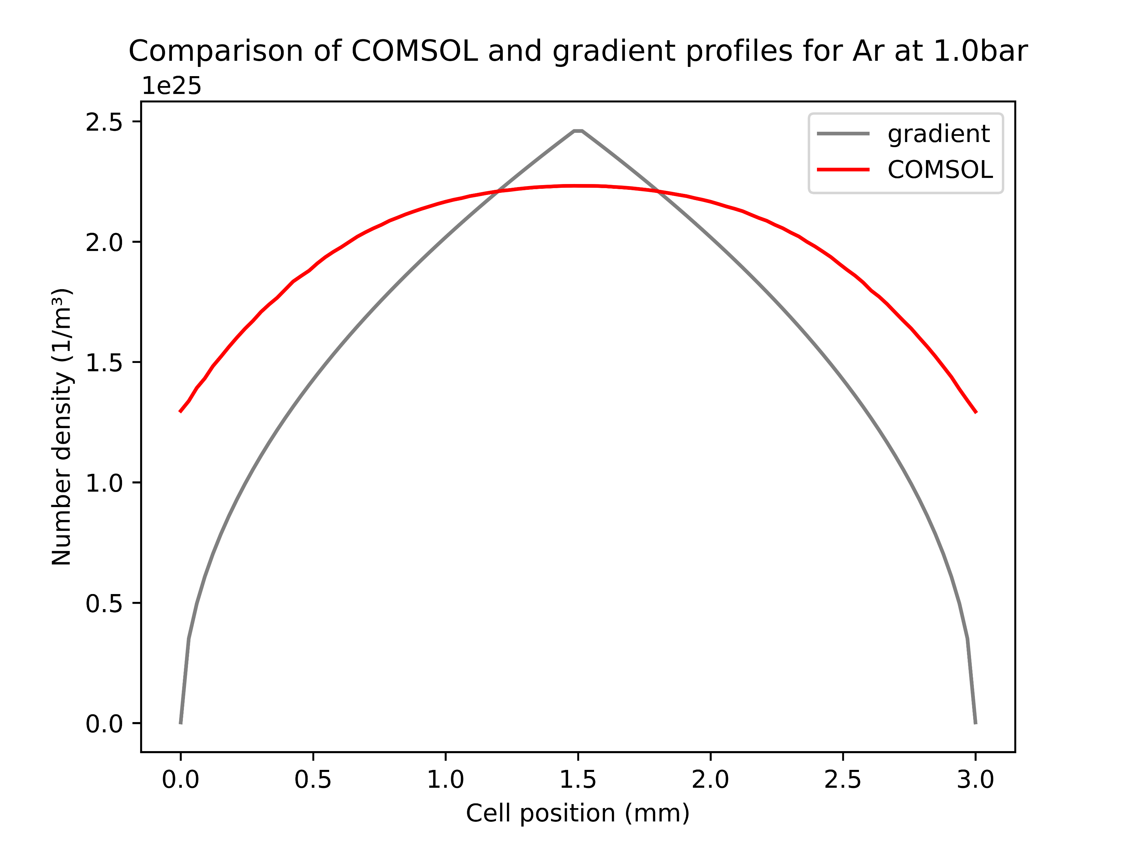
The density profiles
The gradient profile has a higher peak and steeper drop-off than COMSOL
This difference is (qualitatively) unchanged when varying the pressure
Most importantly but not shown here: COMSOL also includes the region outside the cell (3.5cm on either side)
Overall, fairly good agreement of the two models within the cell

Slide 6
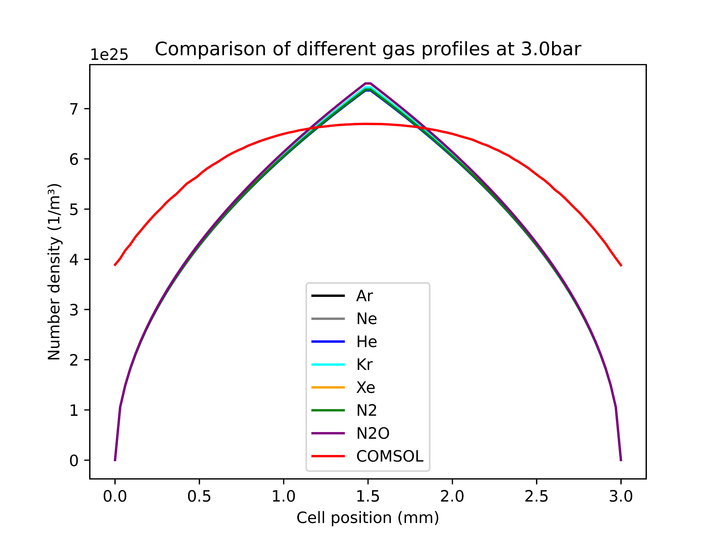
The density profiles
The COMSOL simulations are only based on Argon
However, at the given pressures there is barely any difference in the density profiles of various gases
Thus, the COMSOL model was also applied to the other gases in the parameter scans
Note: the COMSOL data used here was not generated with the improved high-Mach model!

Slide 7
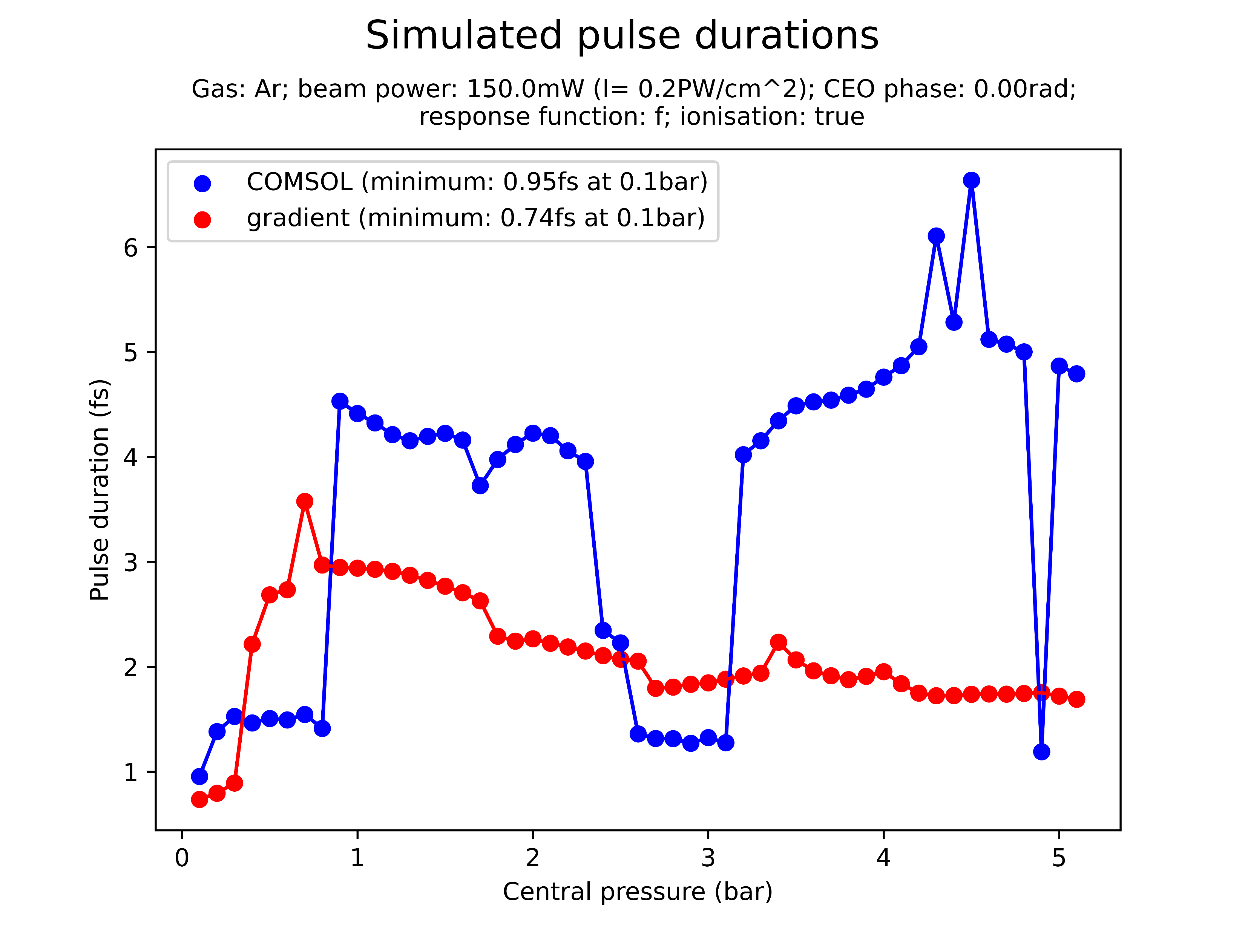
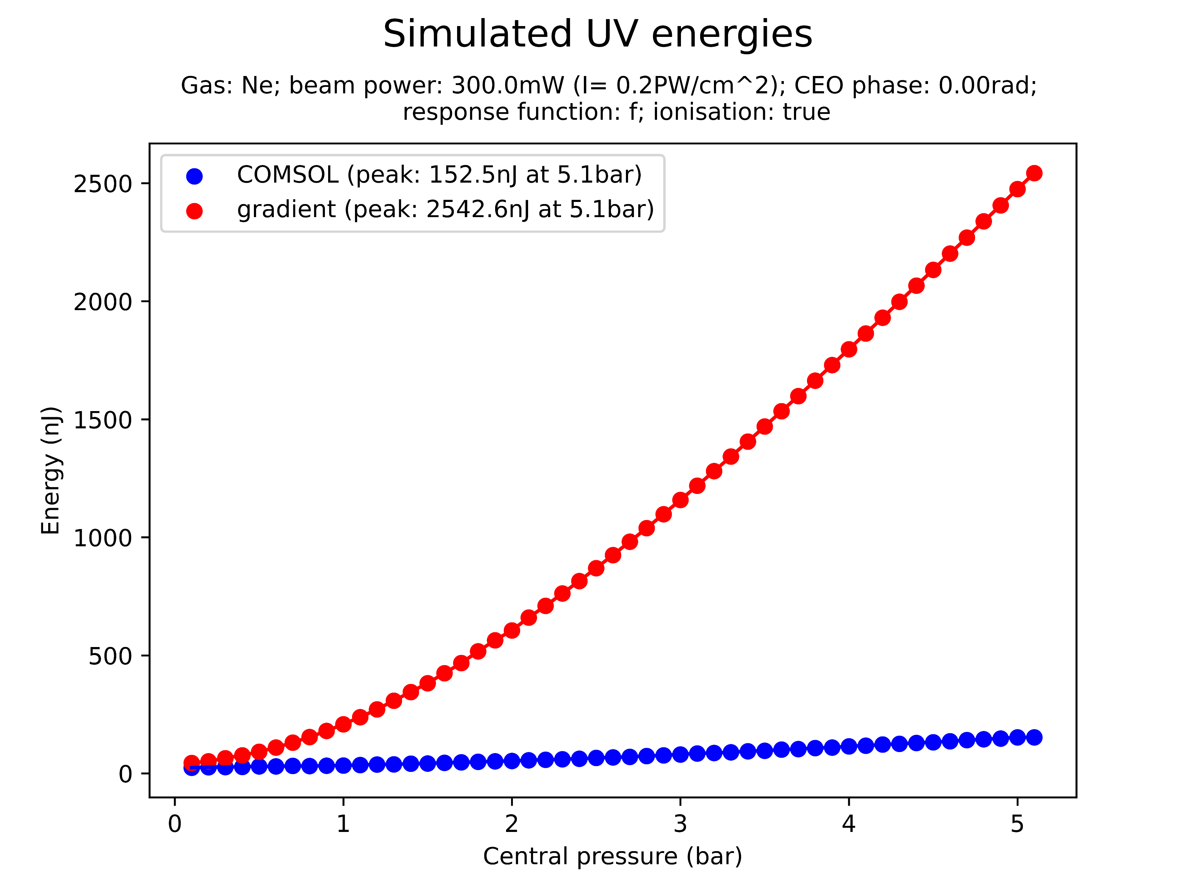
Pressure scan comparisons
The COMSOL and gradient models were compared in a variety of pressure scans
Across all beam powers and pressures, COMSOL predicts a significantly lower UV energy output
Exception: N2O at 300mW?!
There is also generally disagreement between the simulated pulse duration, although without a clear pattern
Note: FWHM pulse durations are used, which are sensitive to pulse shape and hence could be misleading
Note: the plots above are random examples and not related

Slide 8
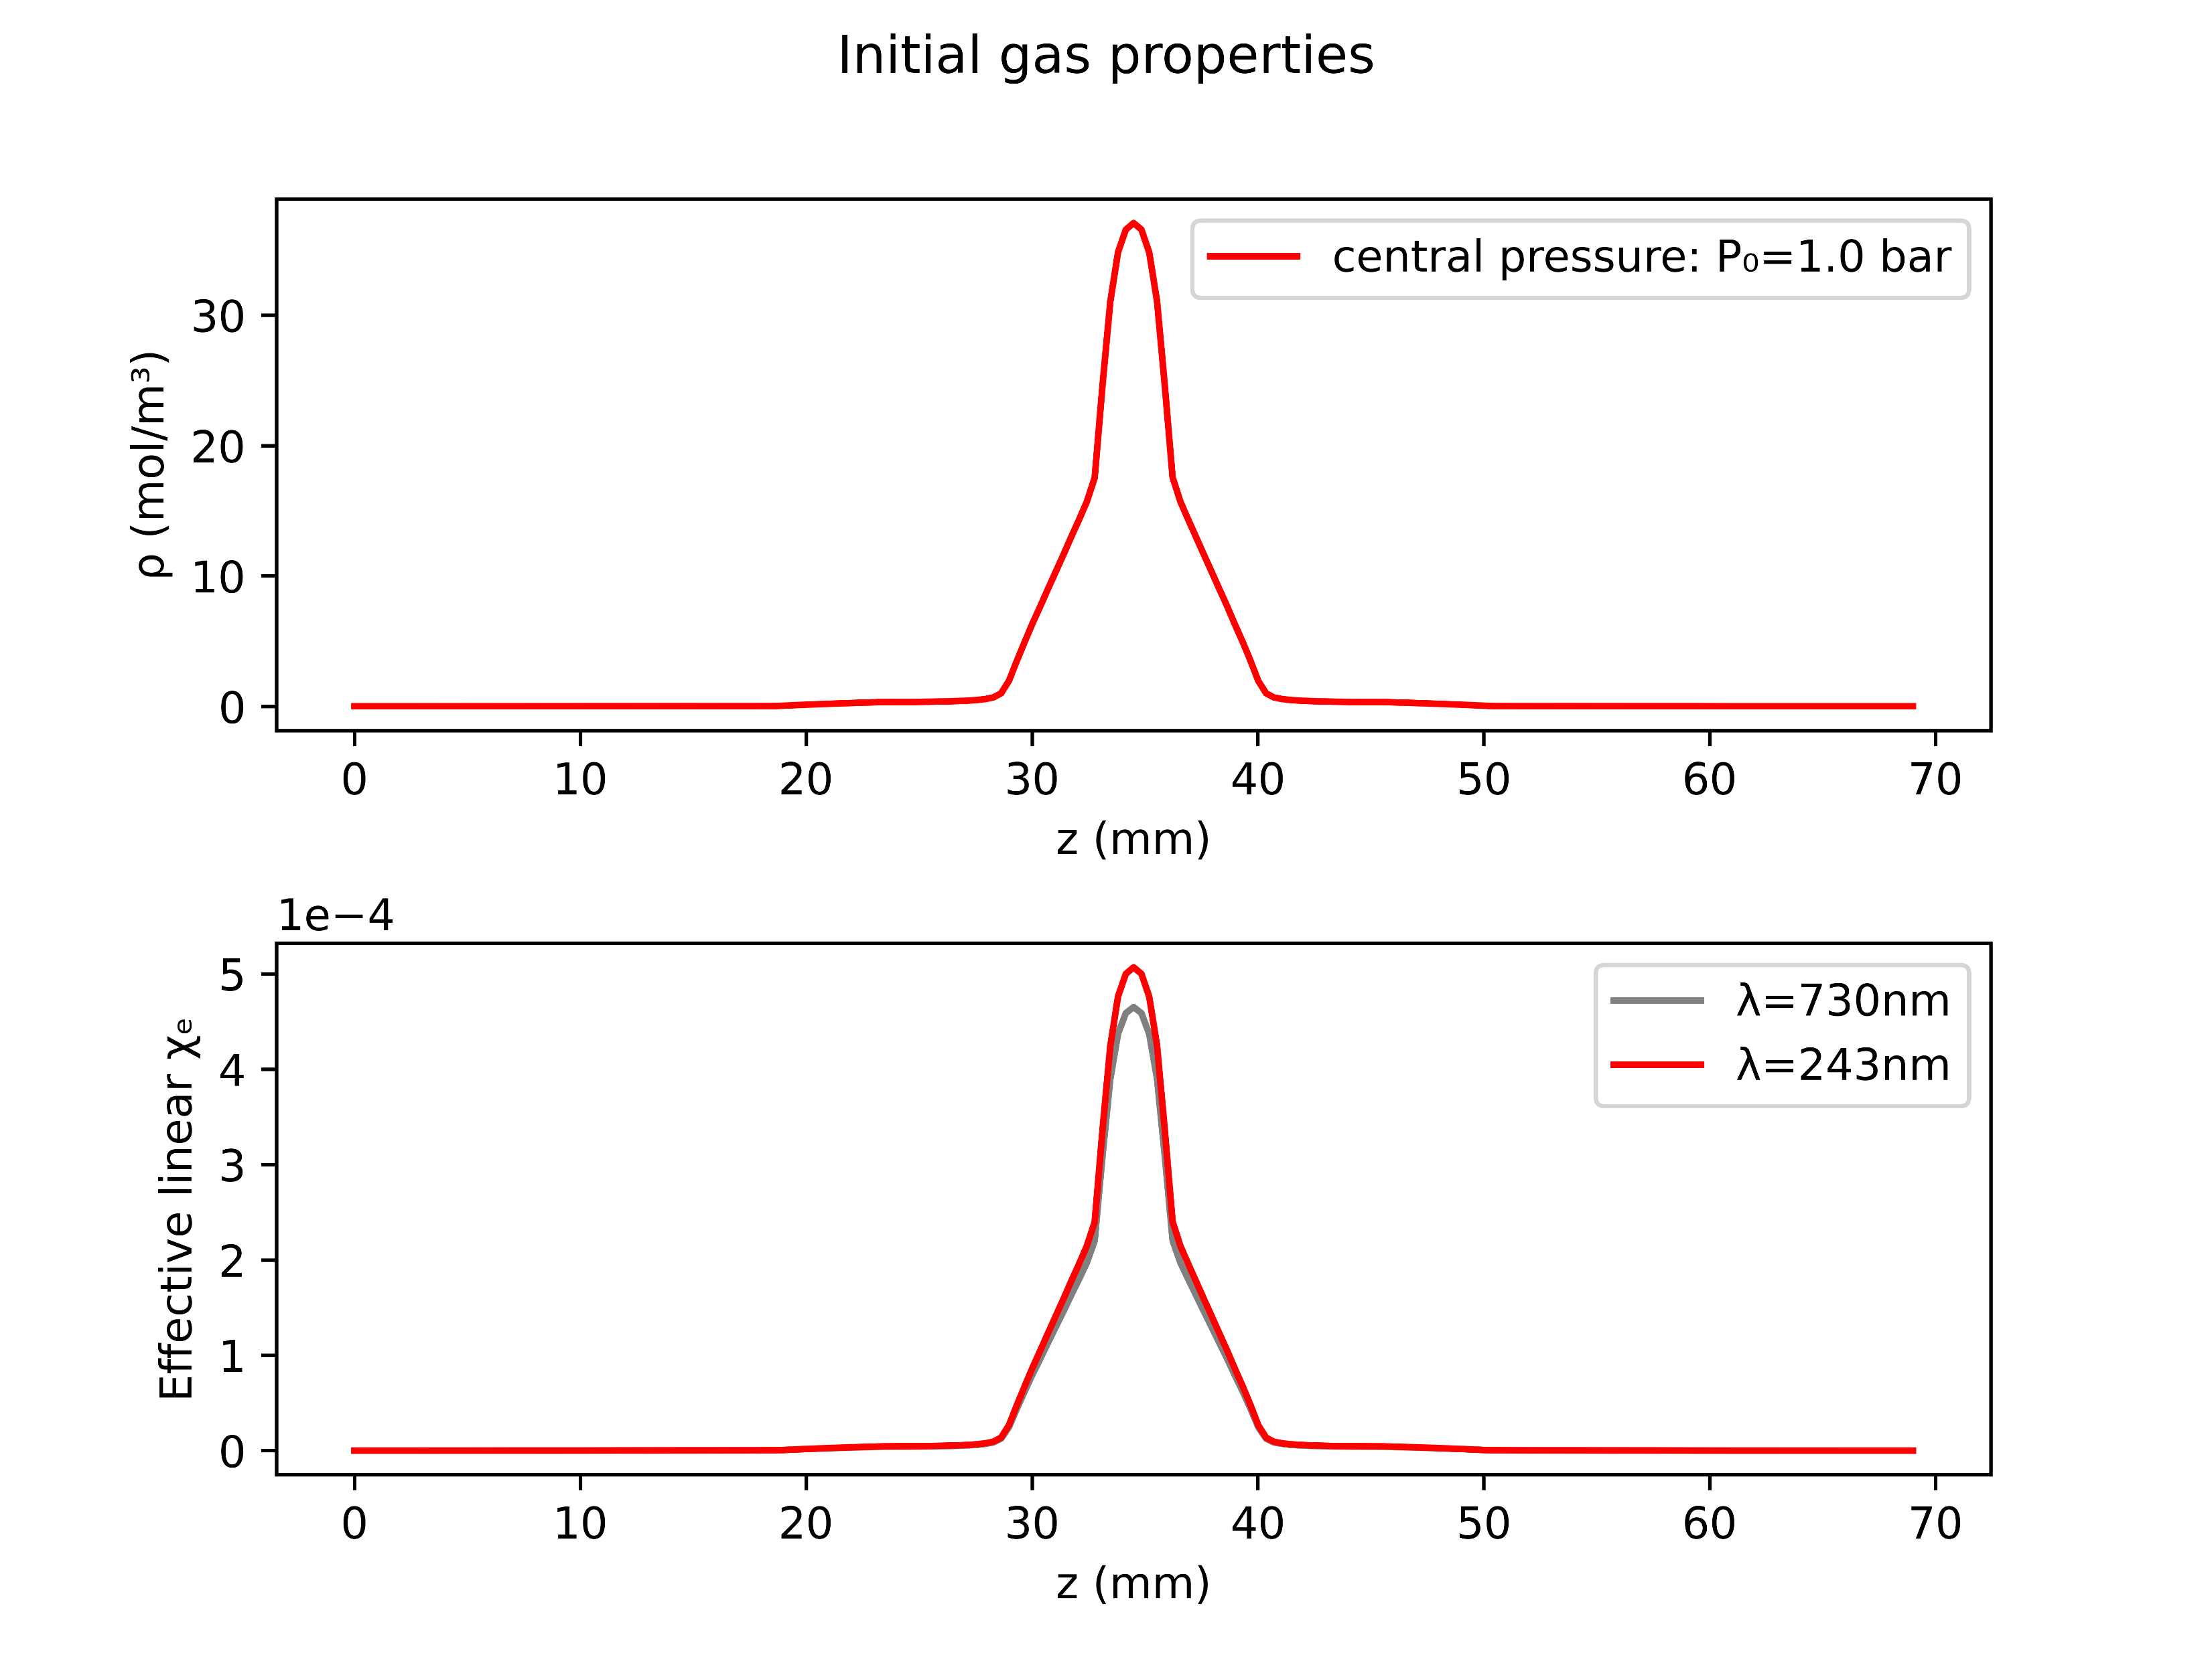
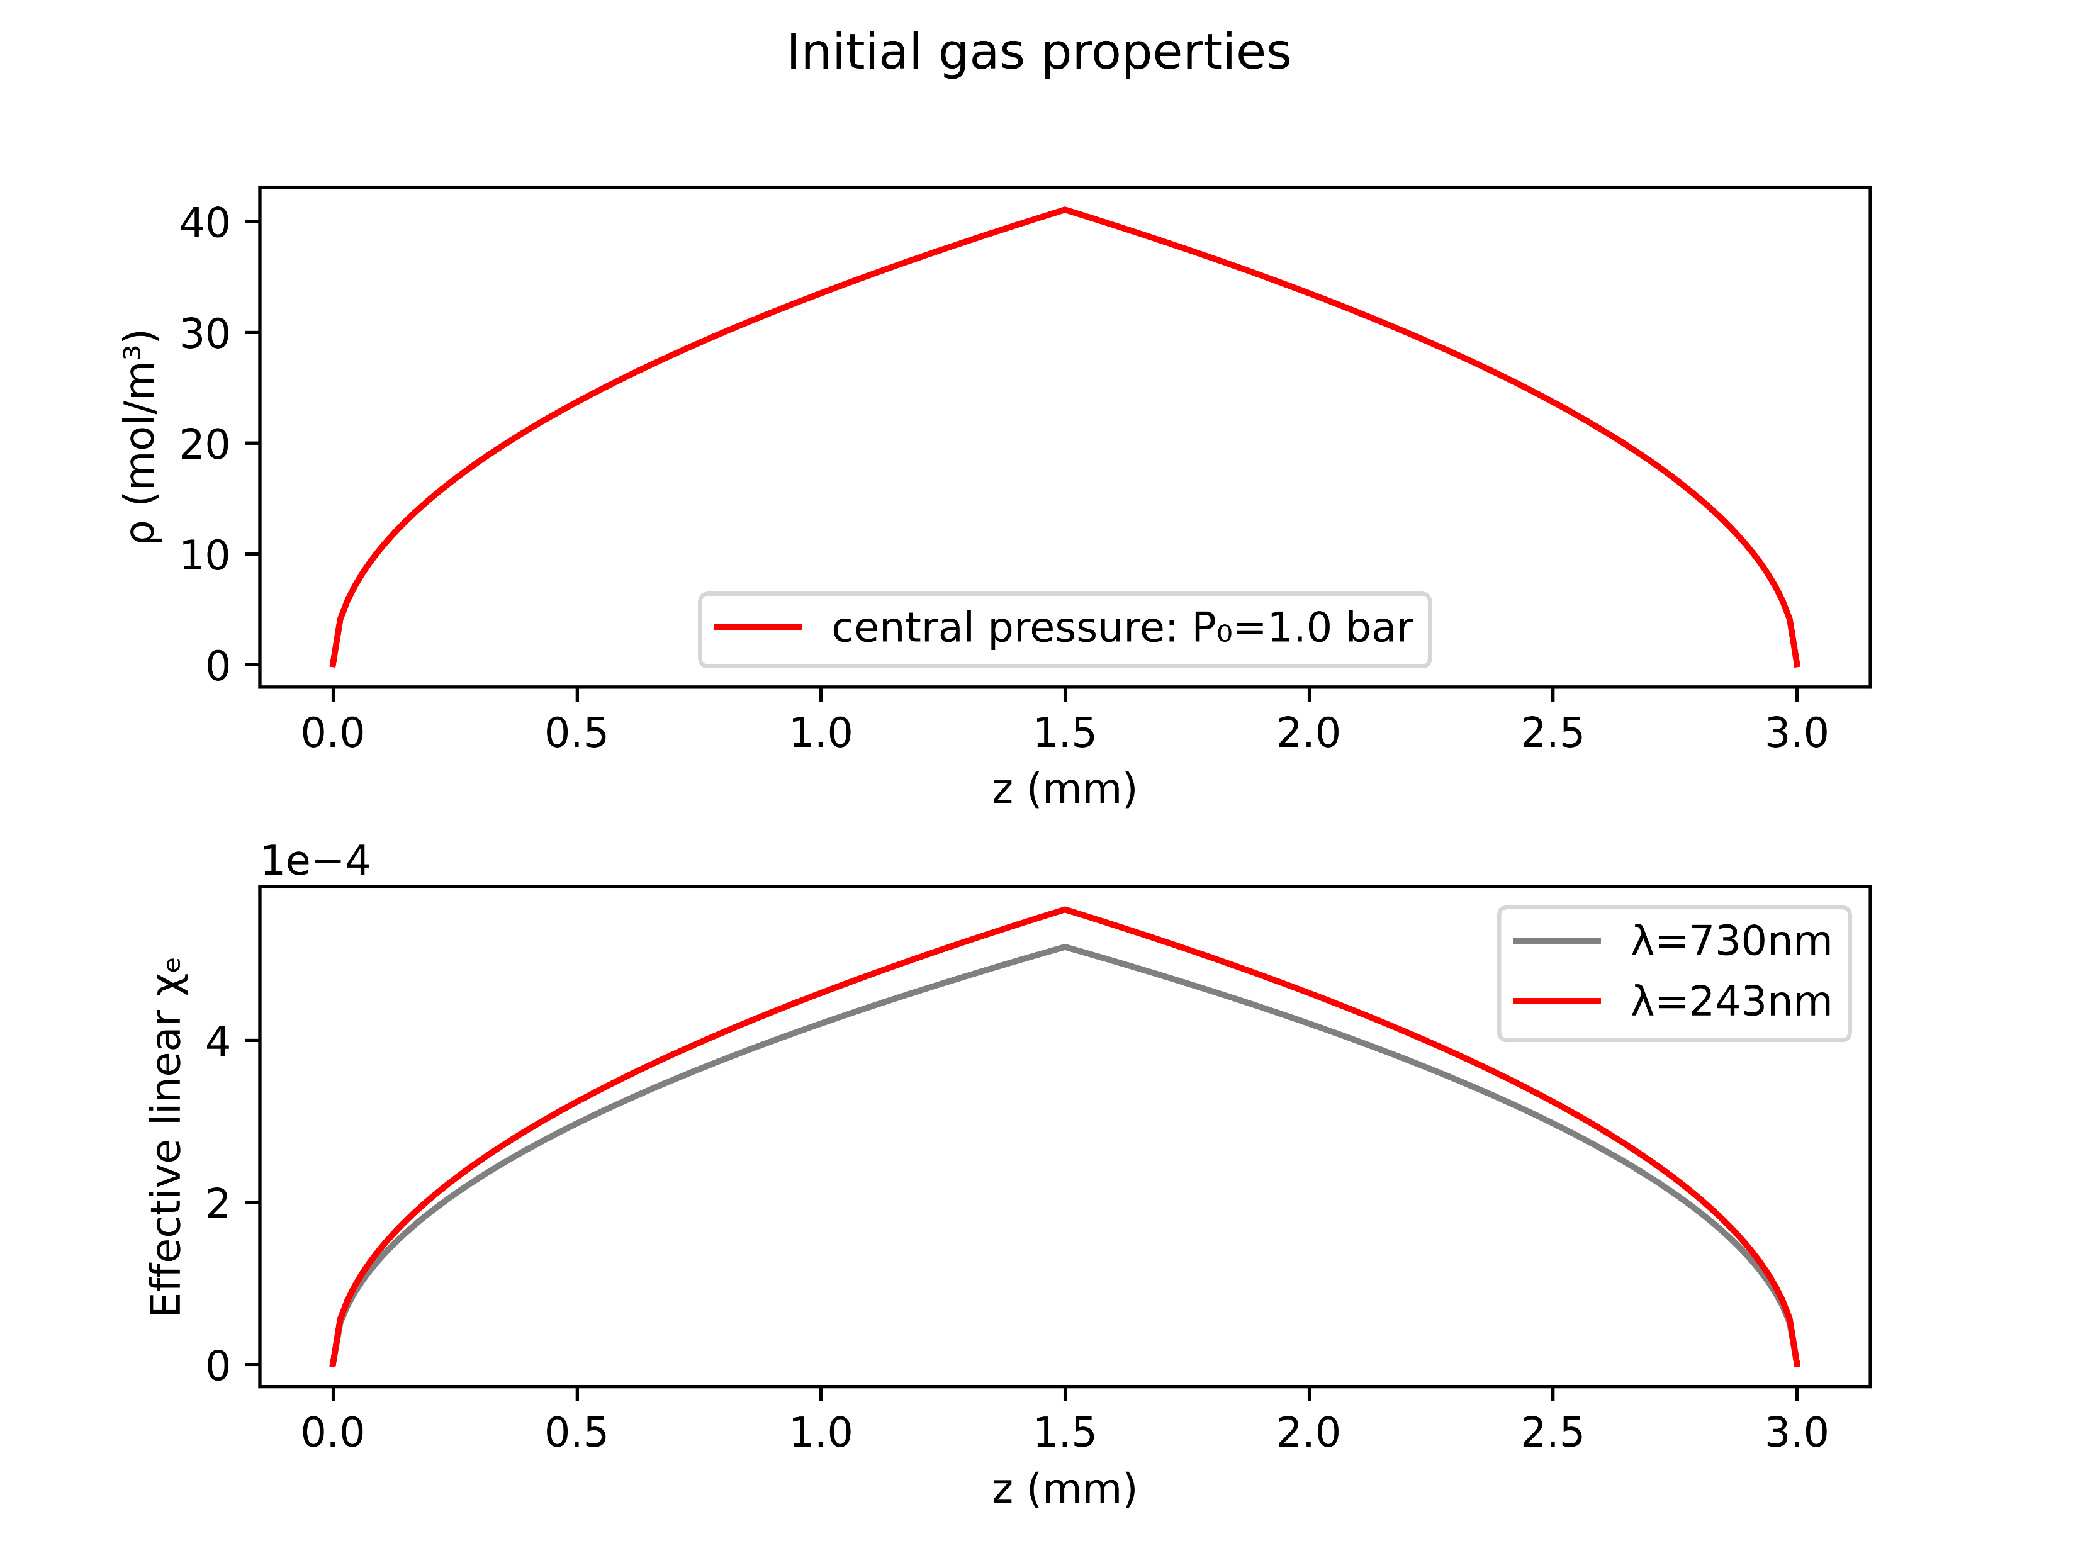
Case study: Argon at 1.0bar with 150mW
COMSOL
gradient

Slide 9
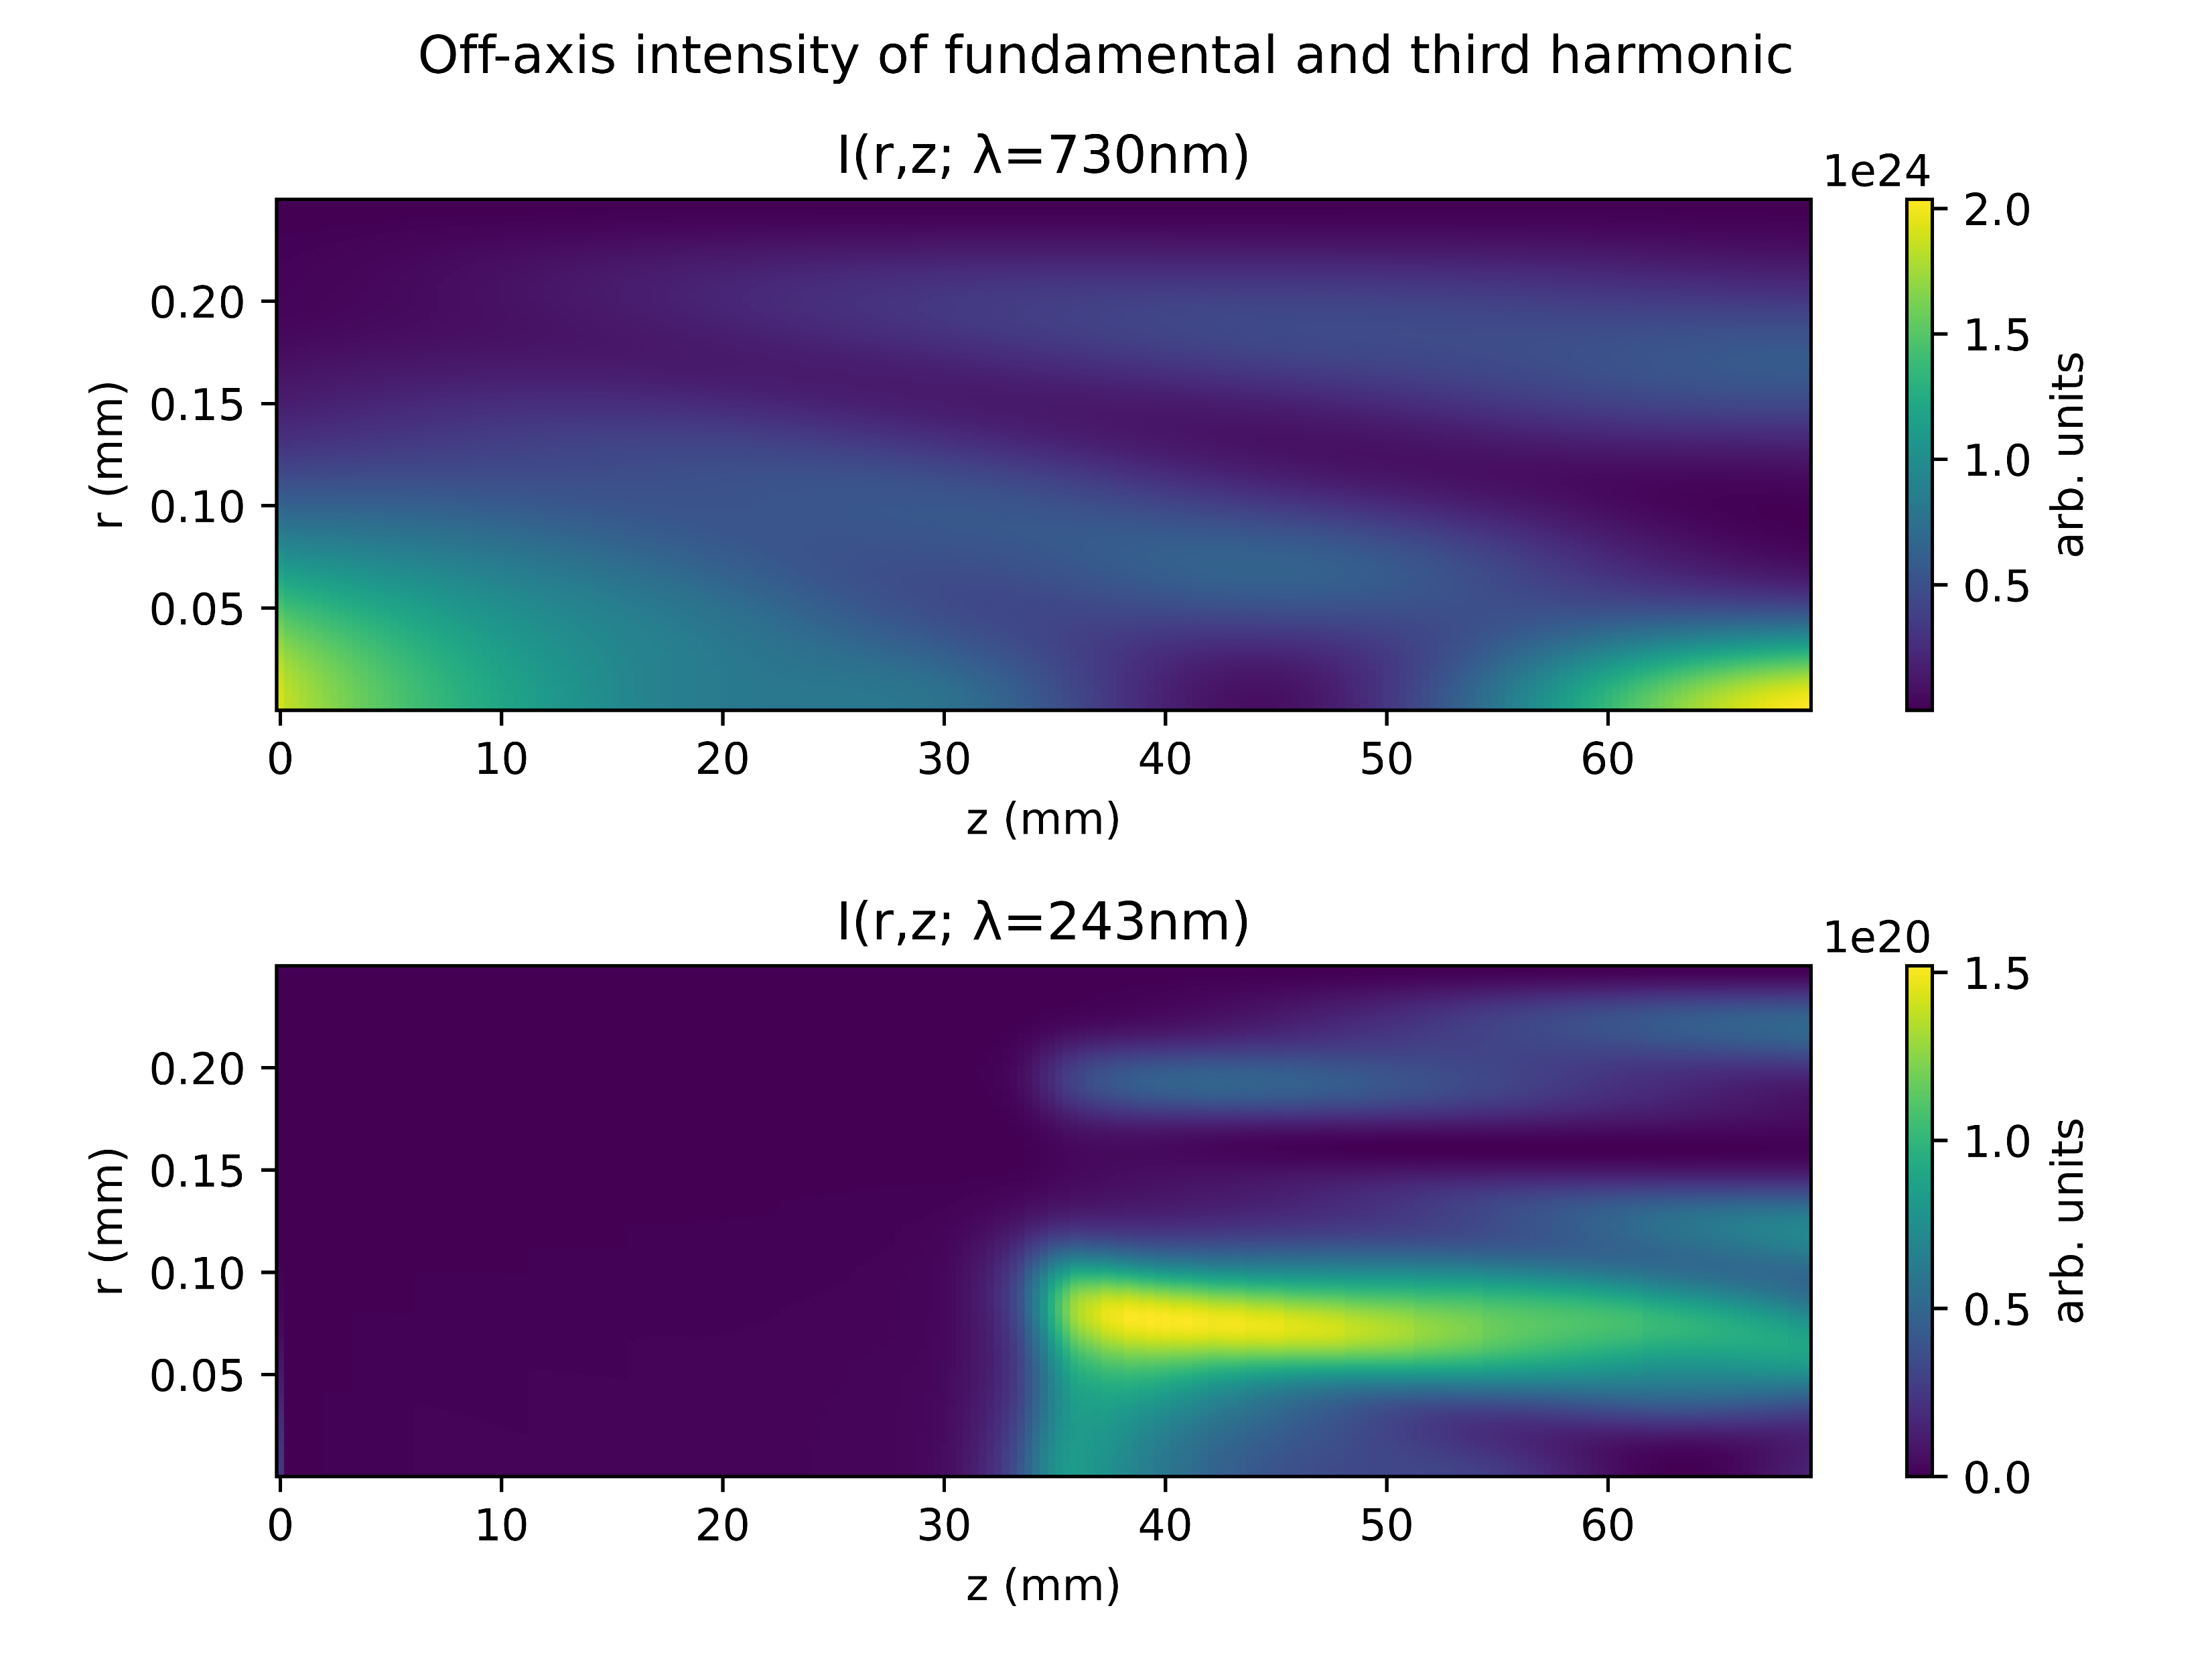
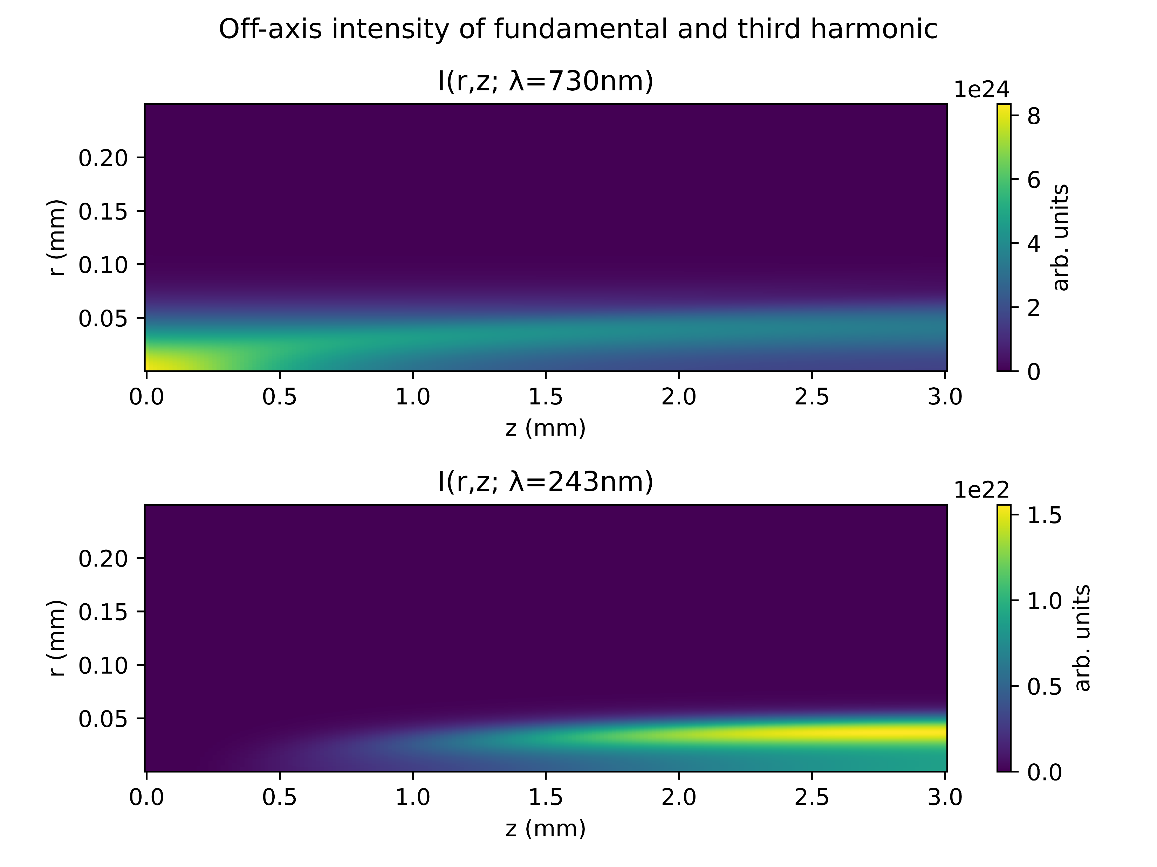
Case study: Argon at 1.0bar with 150mW
COMSOL
gradient

Slide 10
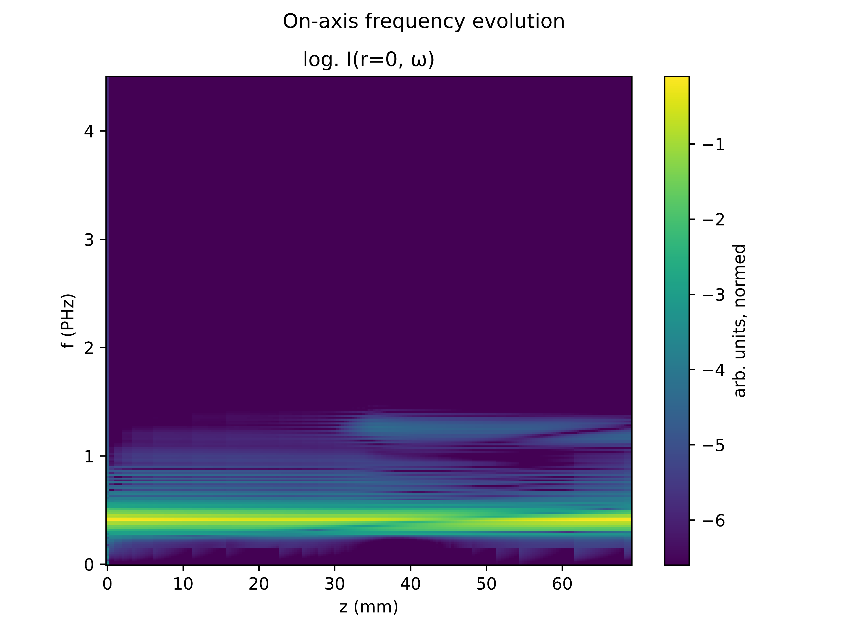
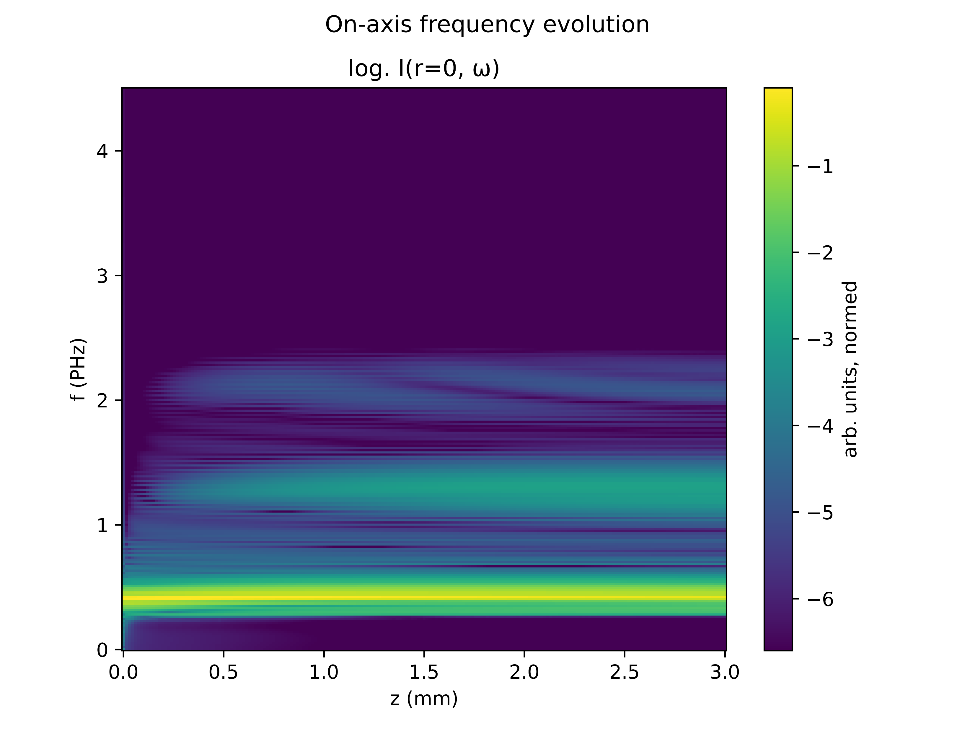
Case study : Argon at 1.0bar with 150mW
COMSOL
gradient

Slide 11
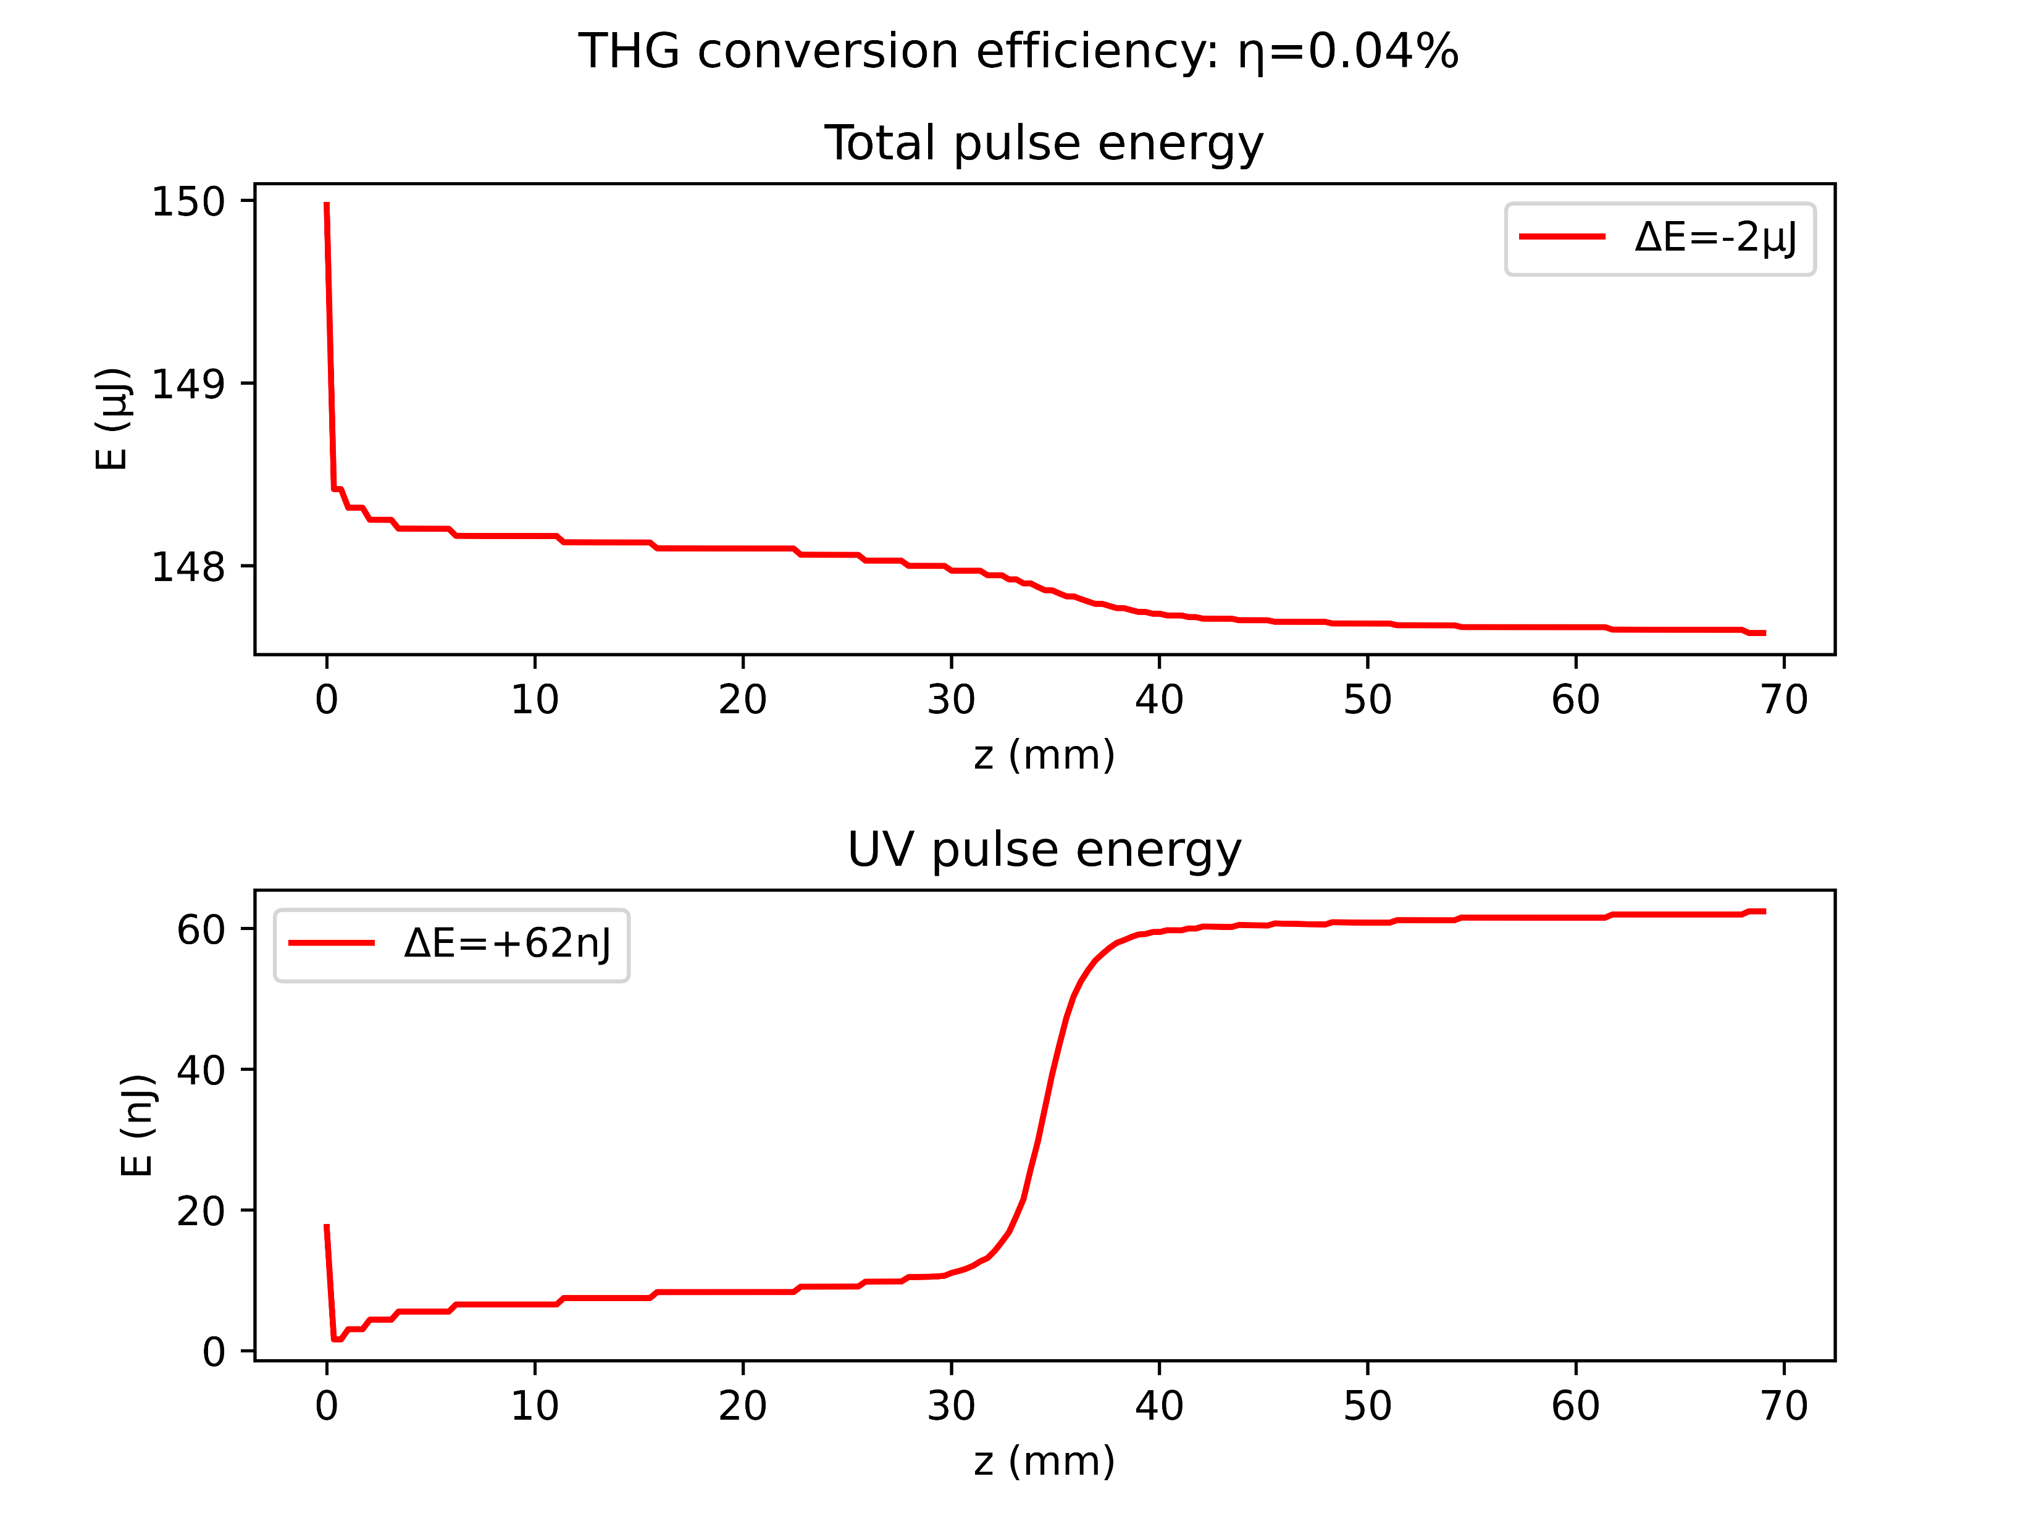
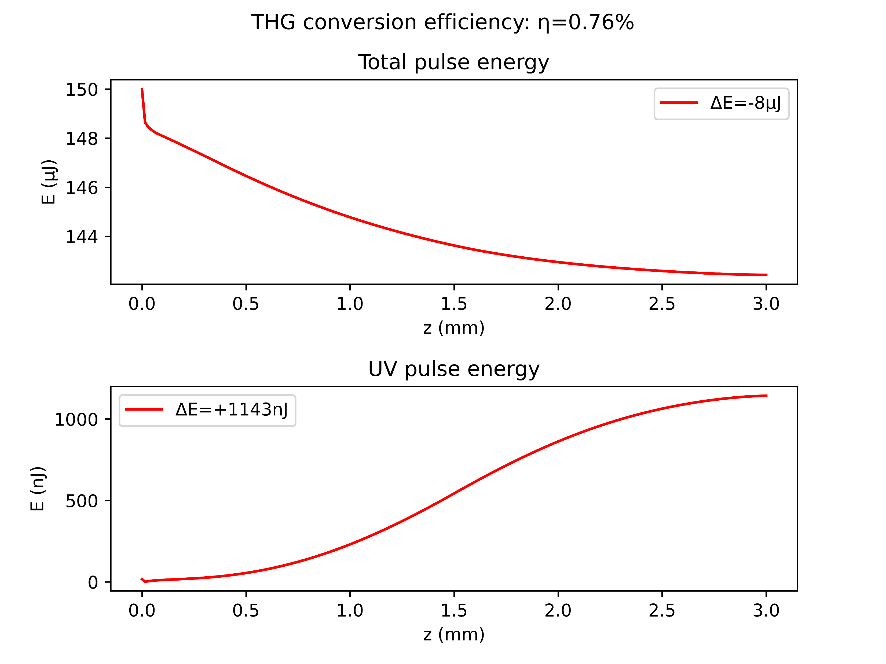
Case study: Argon at 1.0bar with 150mW
COMSOL
gradient

Slide 12
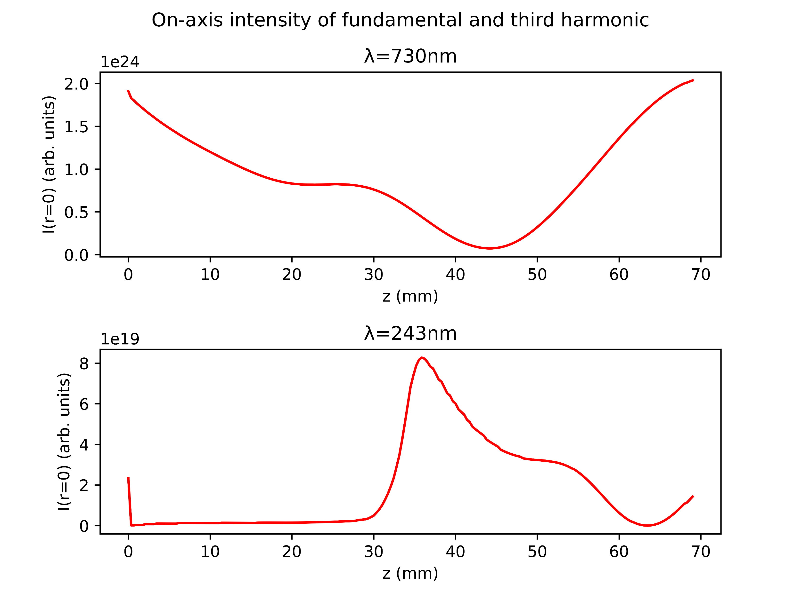
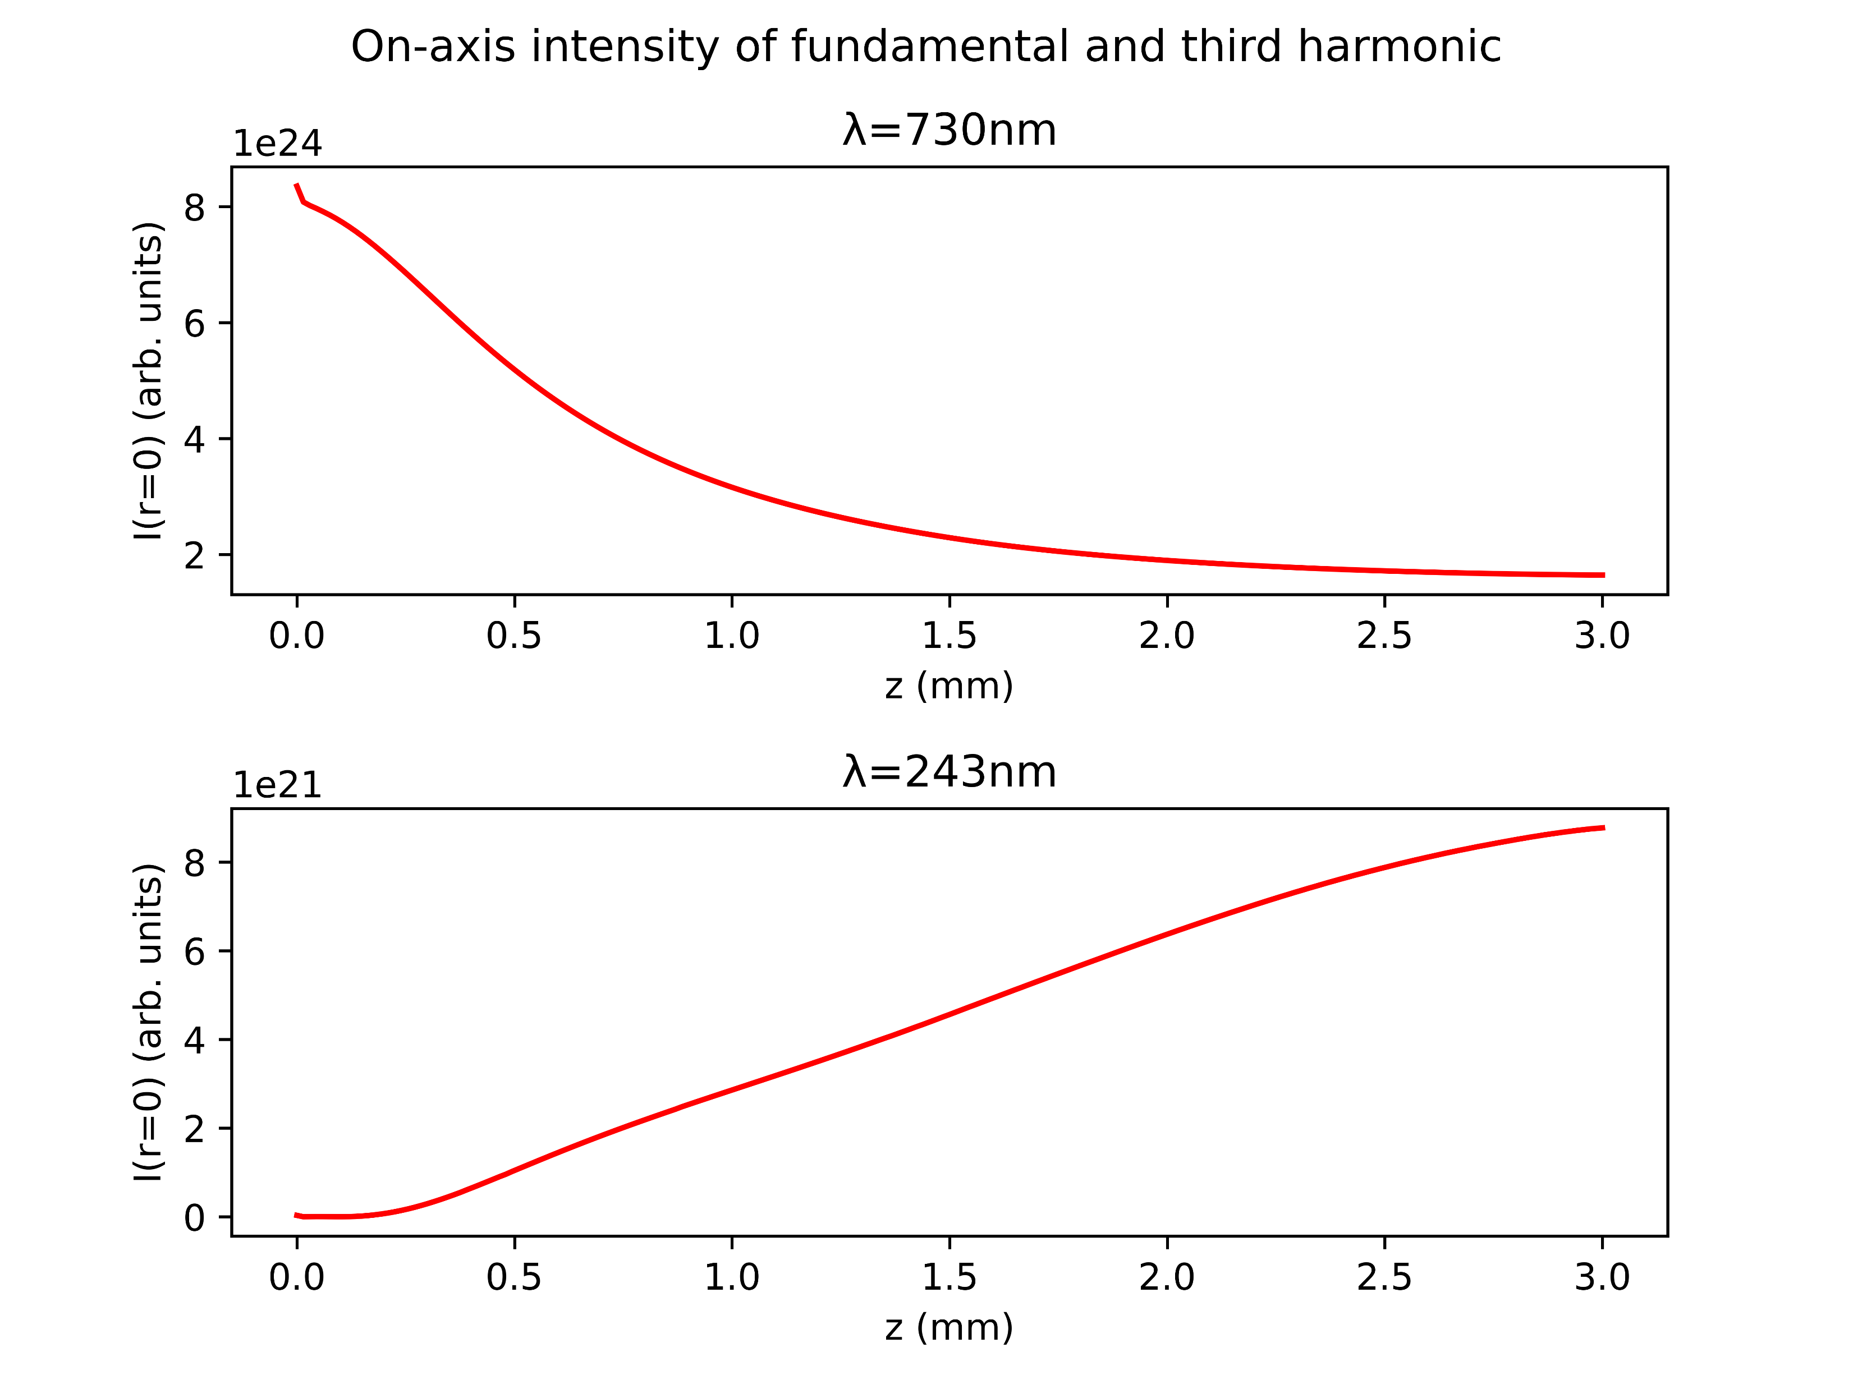
Case study: Argon at 1.0bar with 150mW
COMSOL
gradient

Slide 13
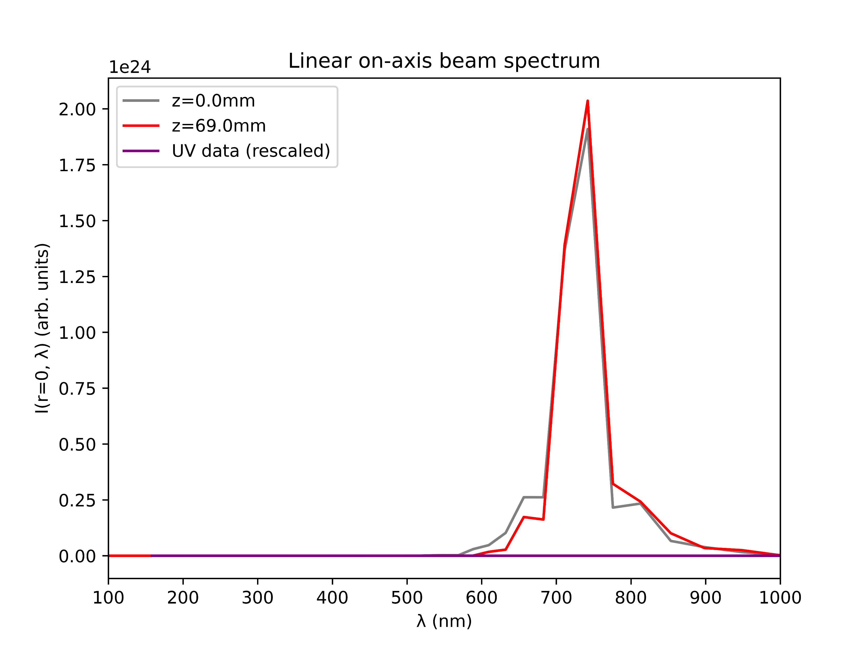
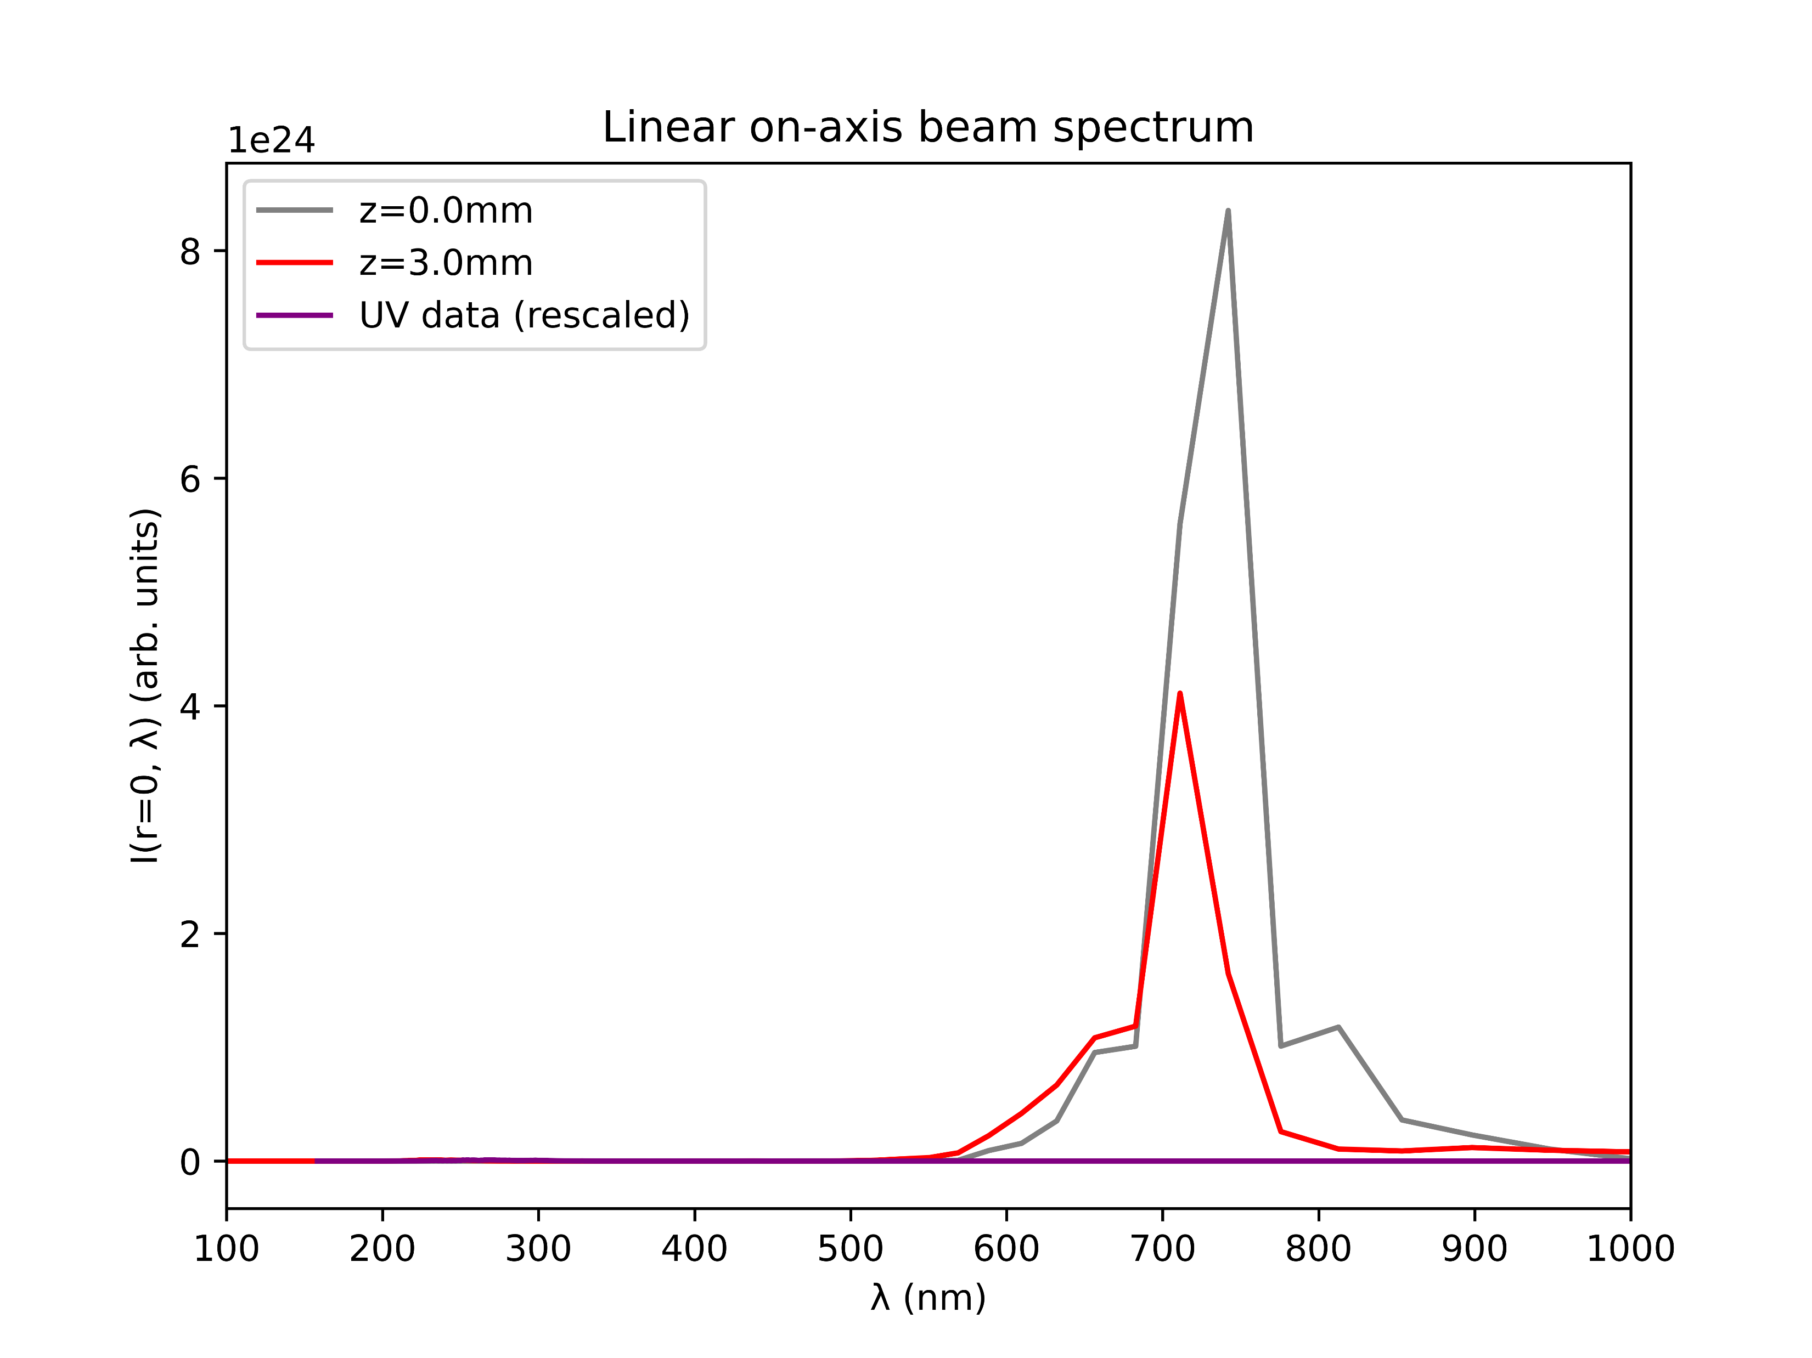
Case study: Argon at 1.0bar with 150mW
COMSOL
gradient

Slide 14
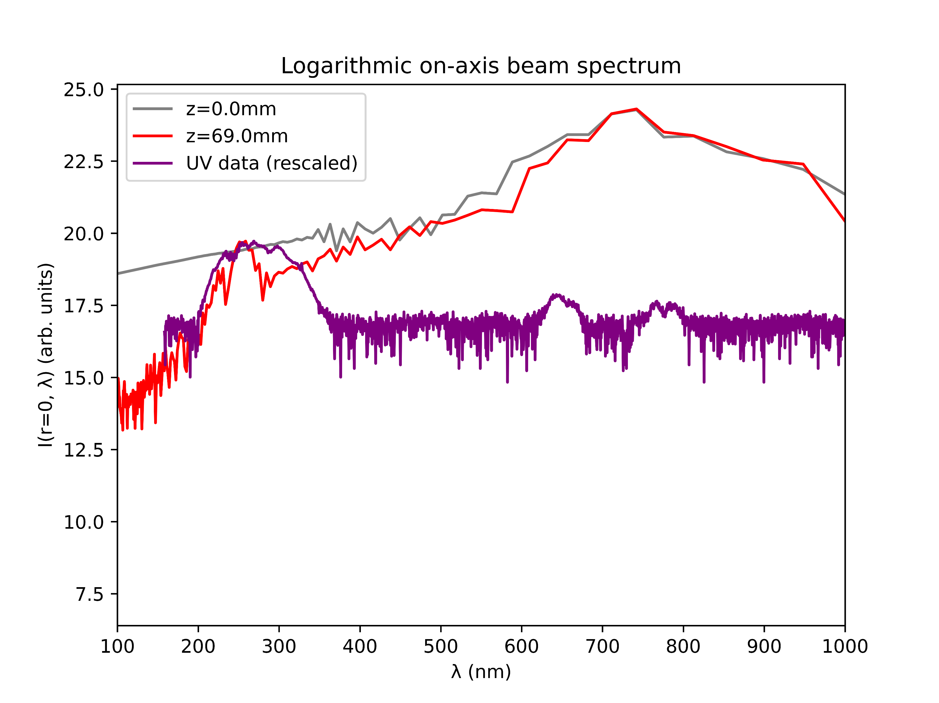
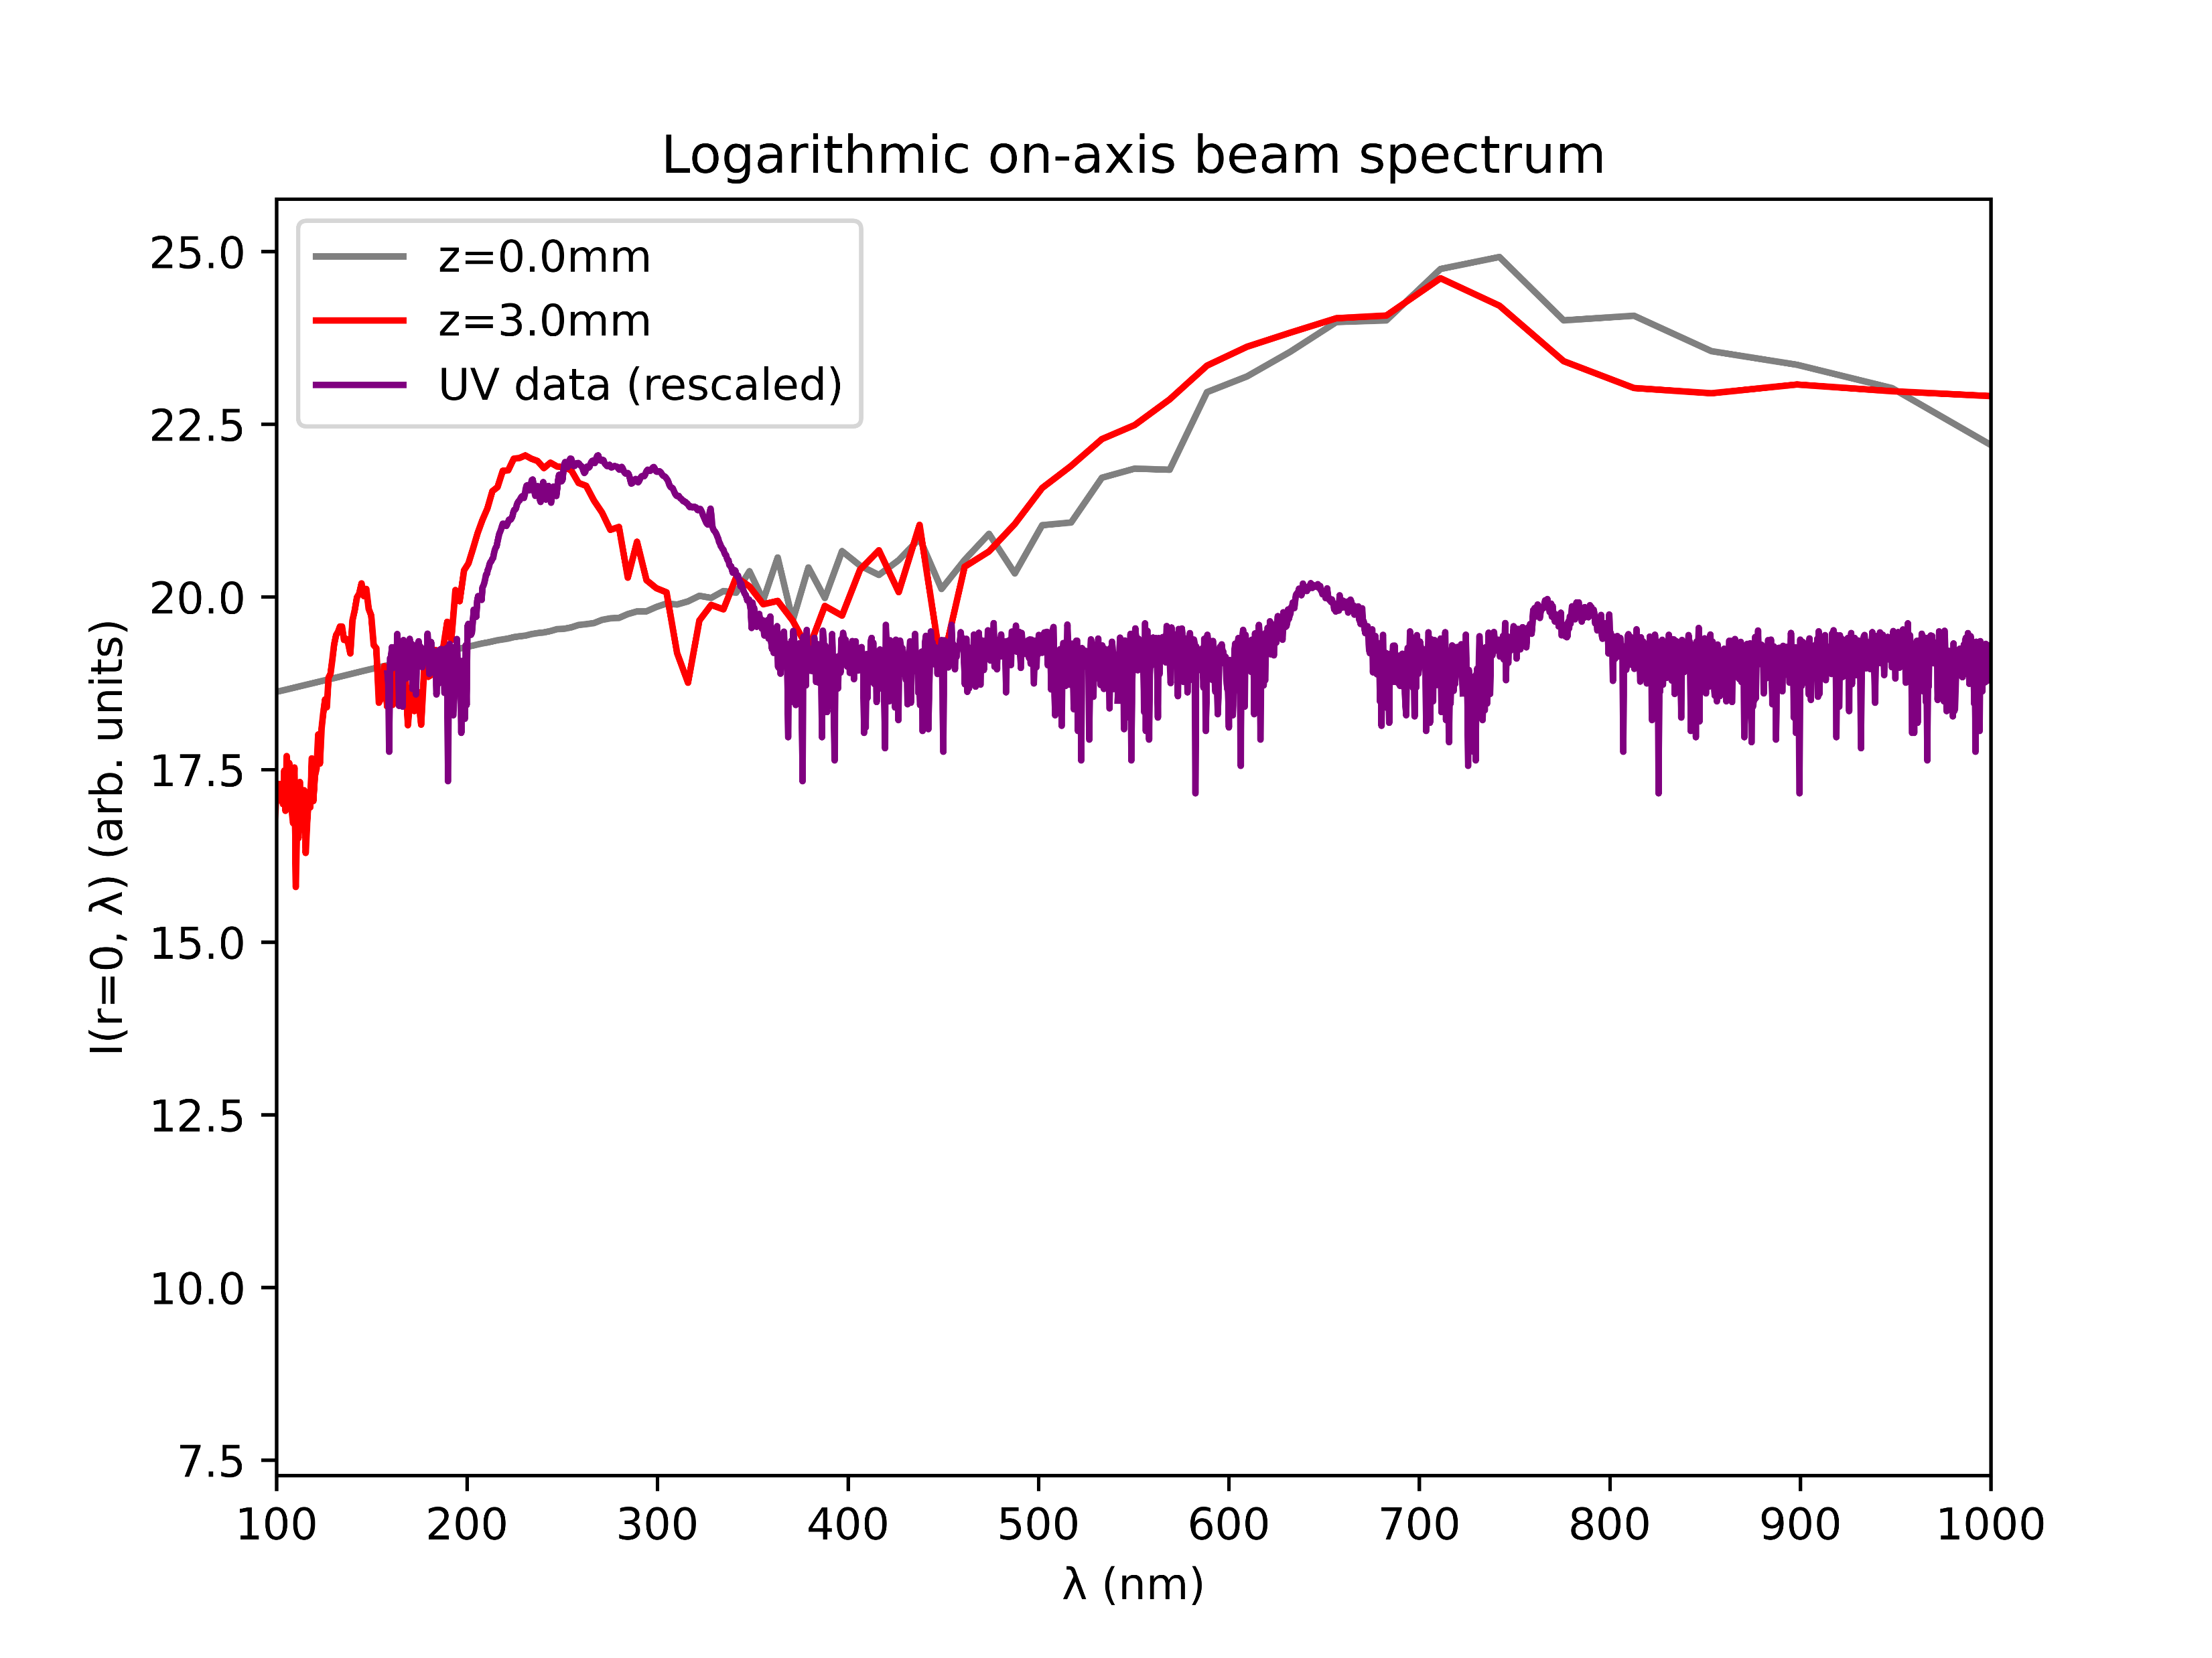
Case study: Argon at 1.0bar with 150mW
COMSOL
gradient

Slide 15
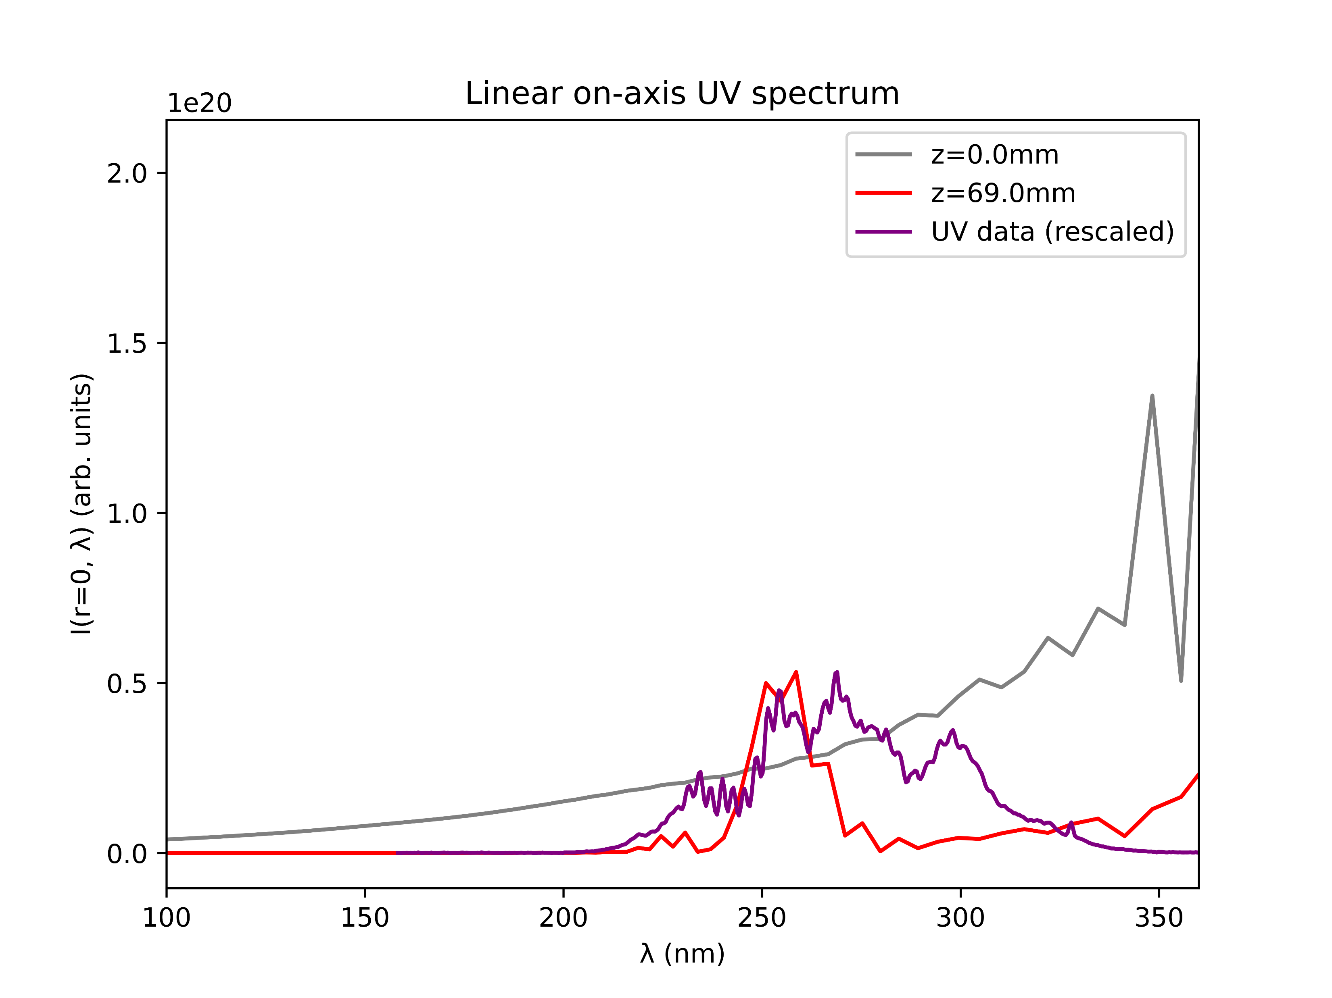
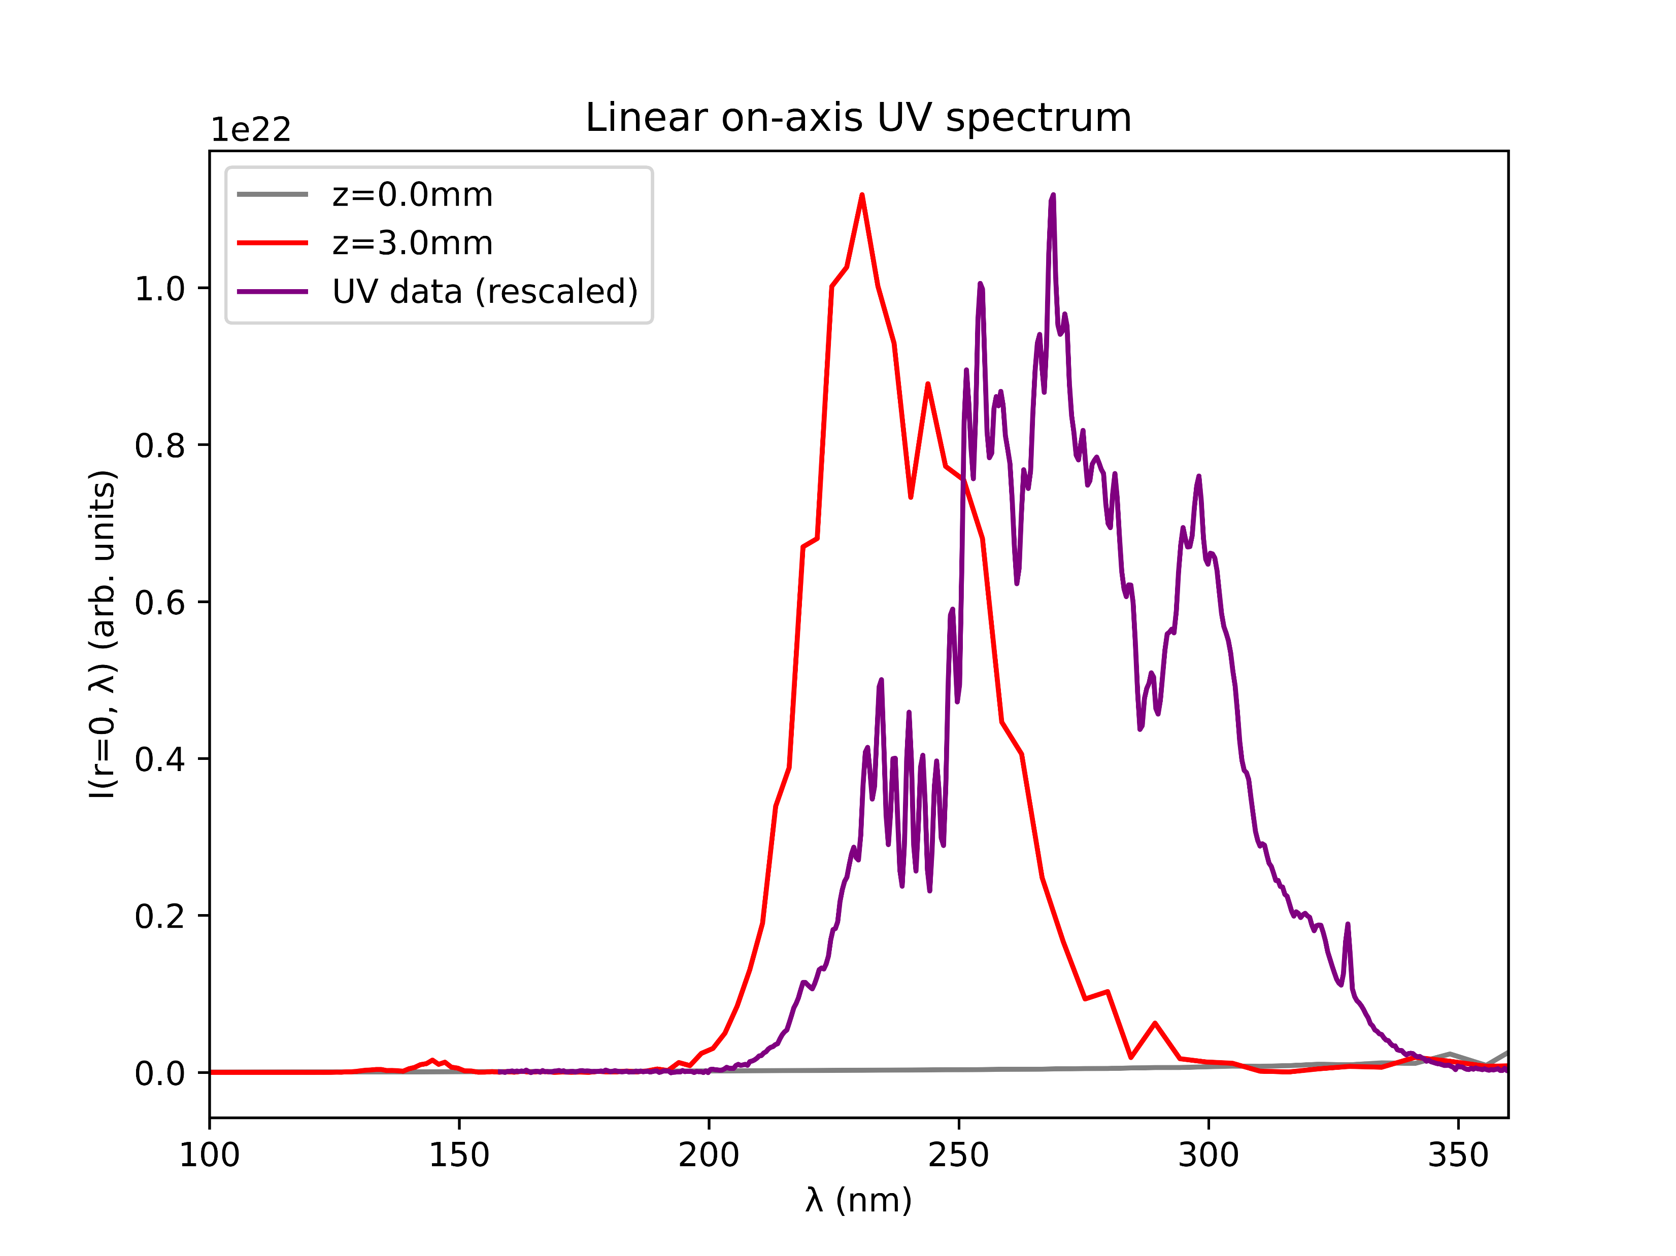
Case study: Argon at 1.0bar with 150mW
COMSOL
gradient

Slide 16
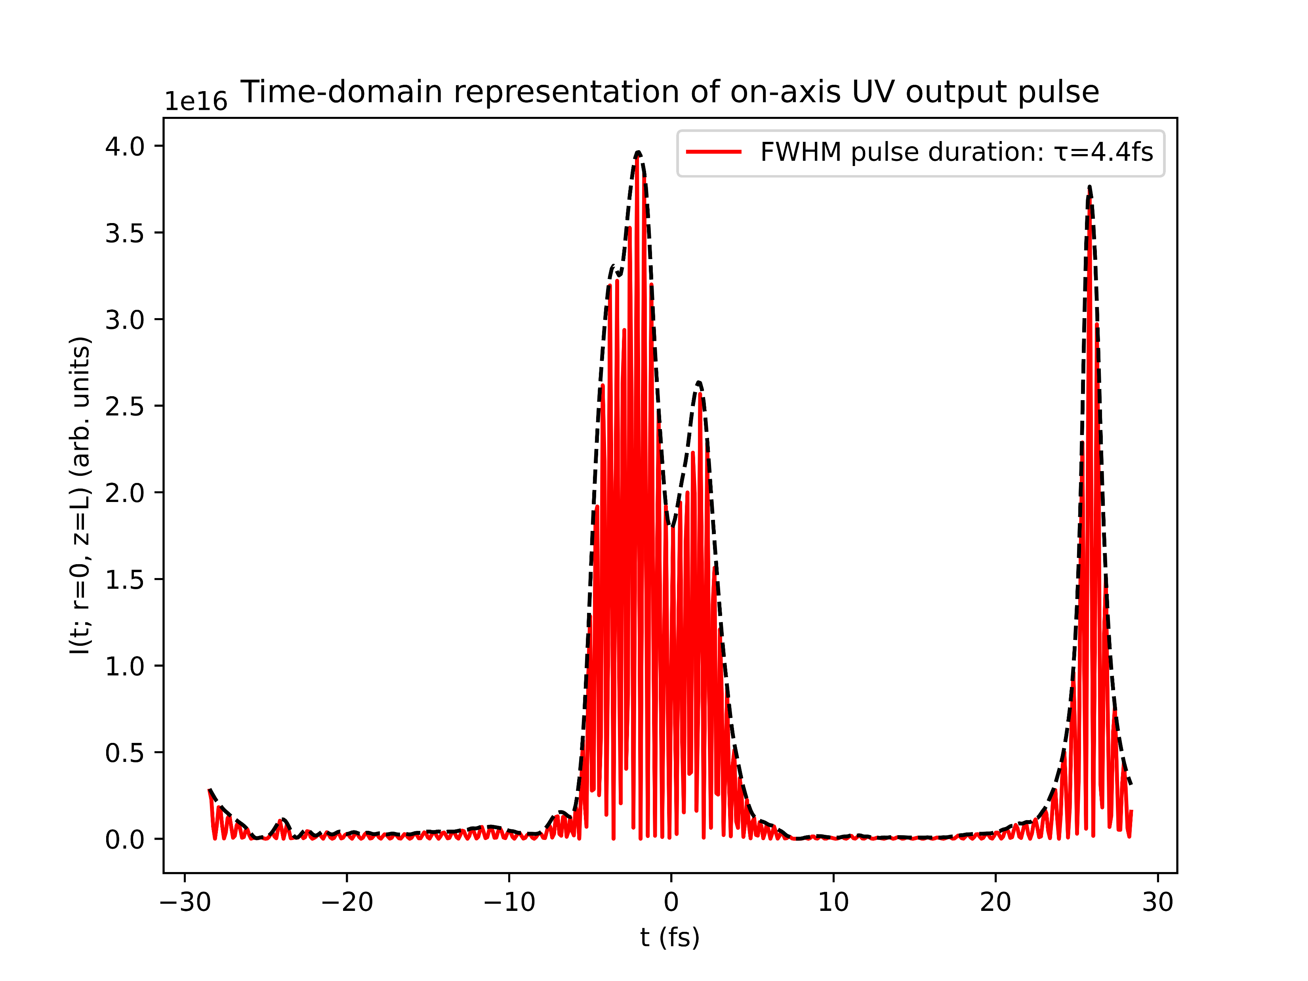
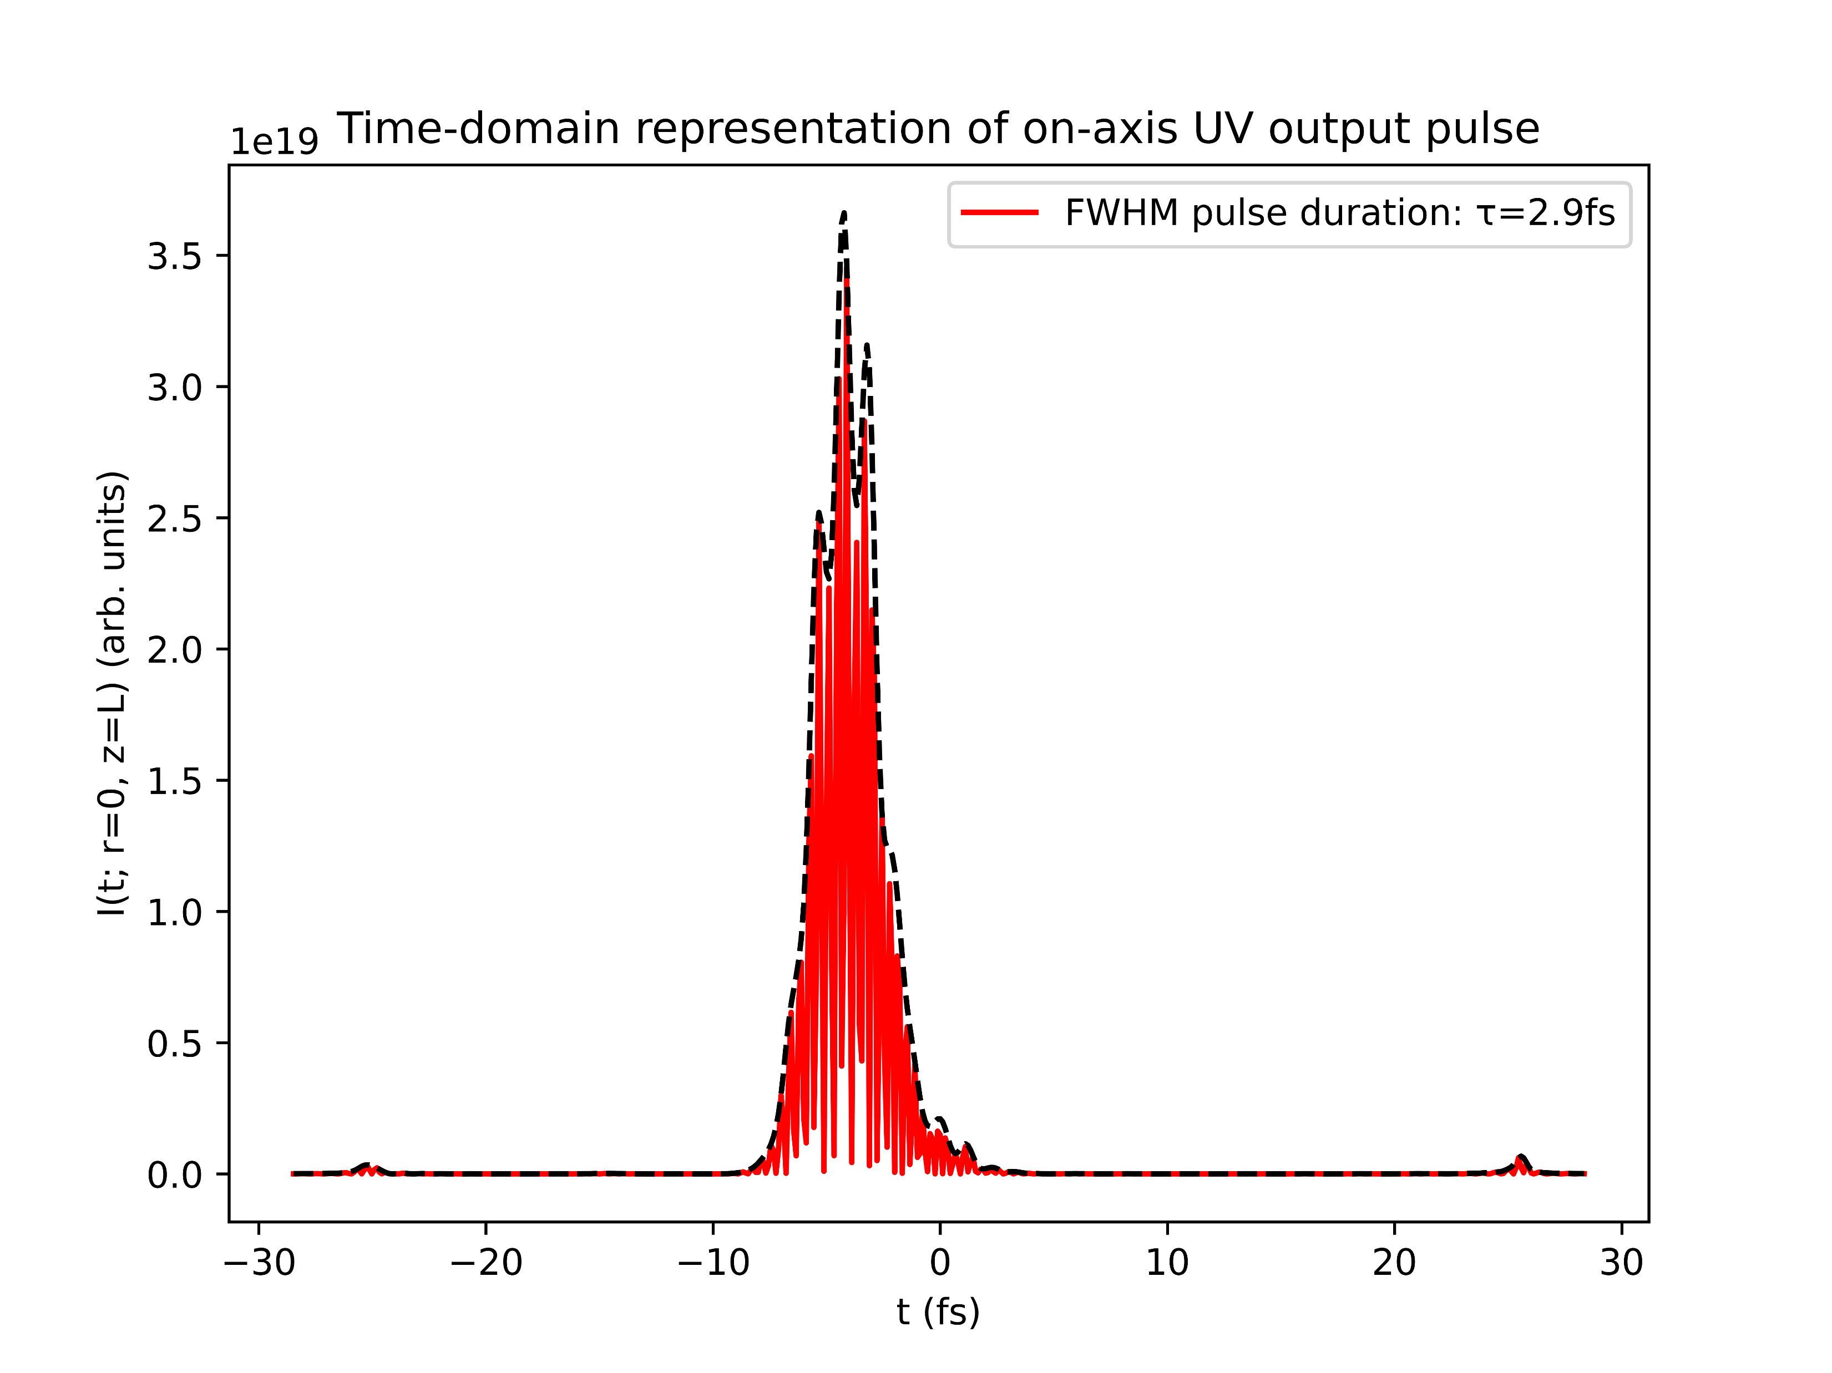
Case study: Argon at 1.0bar with 150mW
COMSOL
gradient

Slide 17
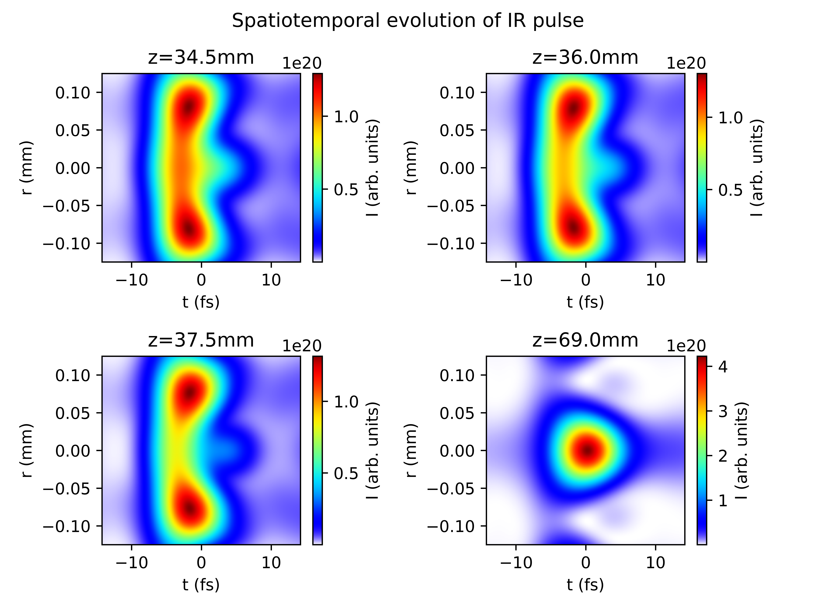
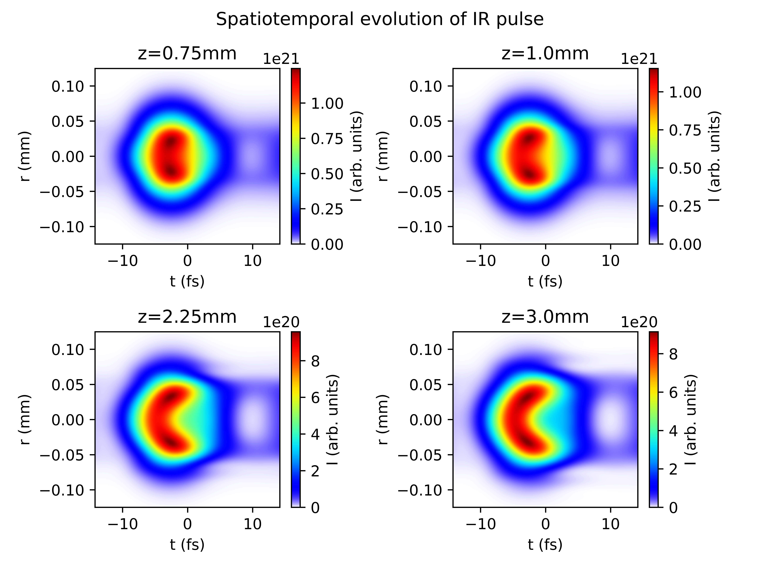
Case study: Argon at 1.0bar with 150mW
COMSOL
gradient

Slide 18
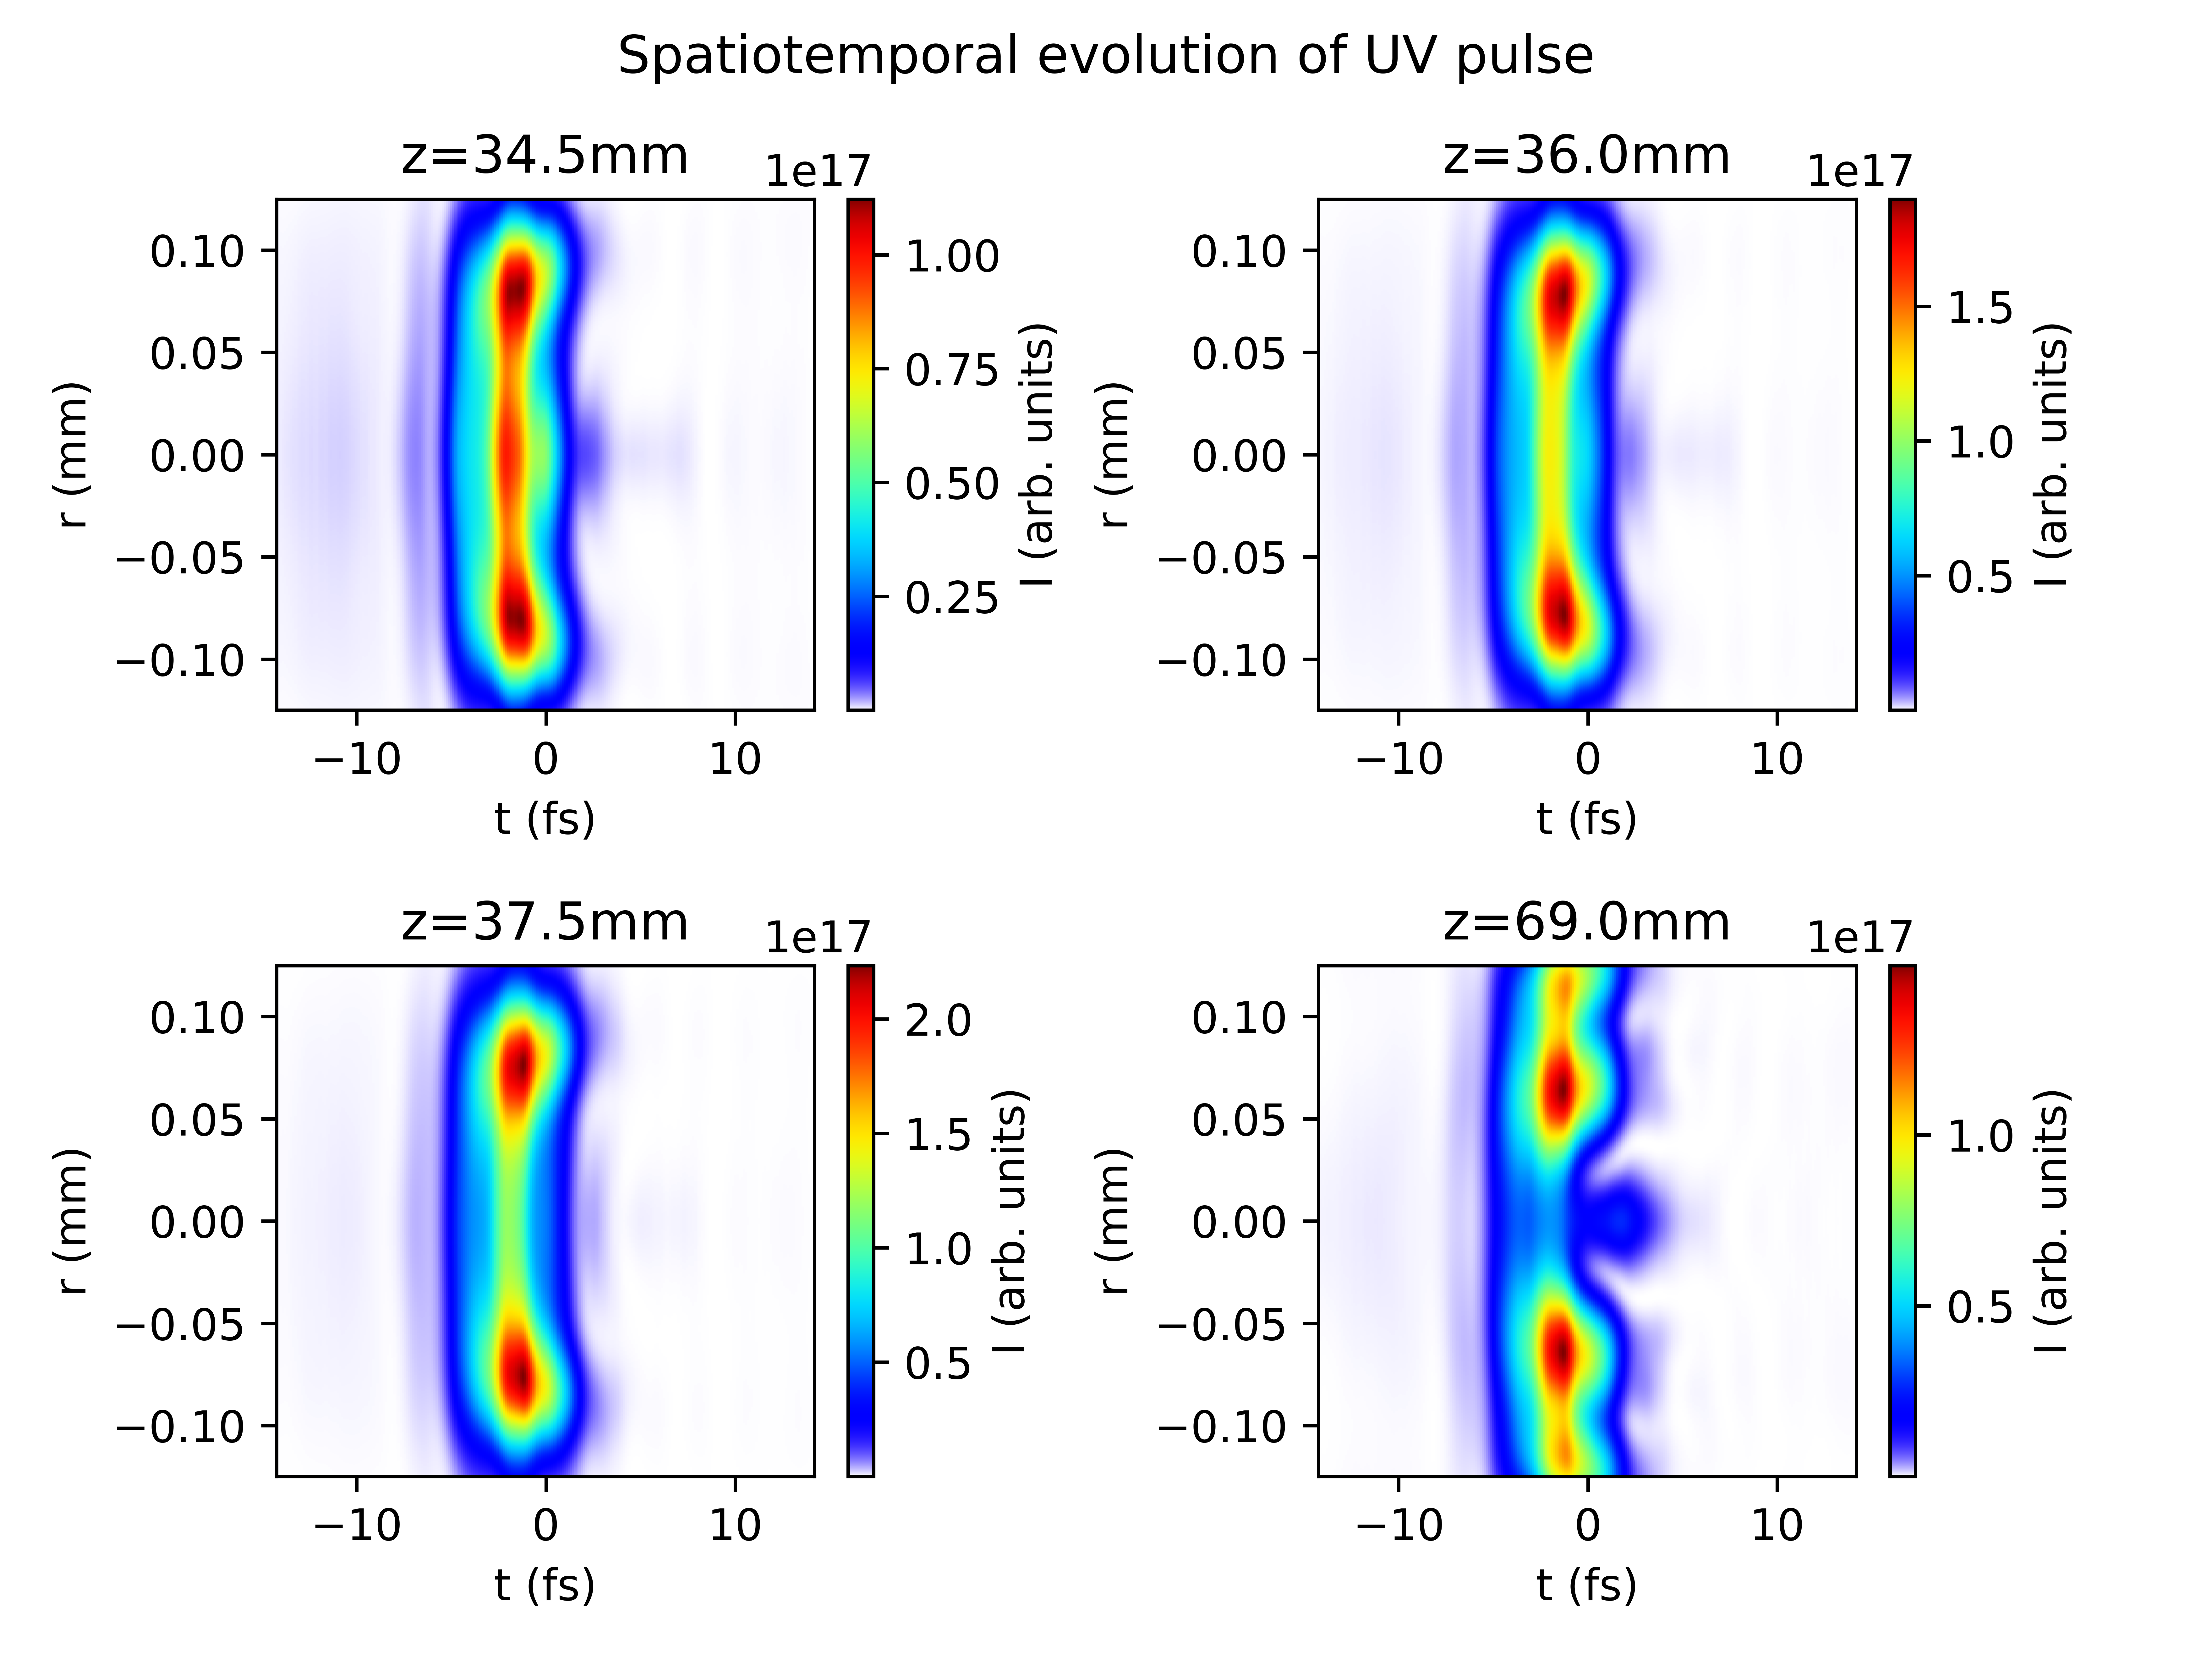
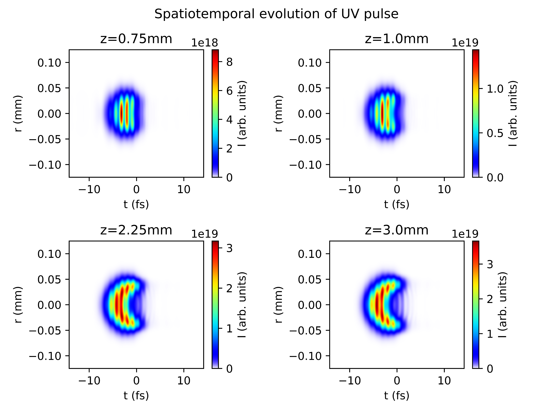
Case study: Argon at 1.0bar with 150mW
COMSOL
gradient

Slide 19
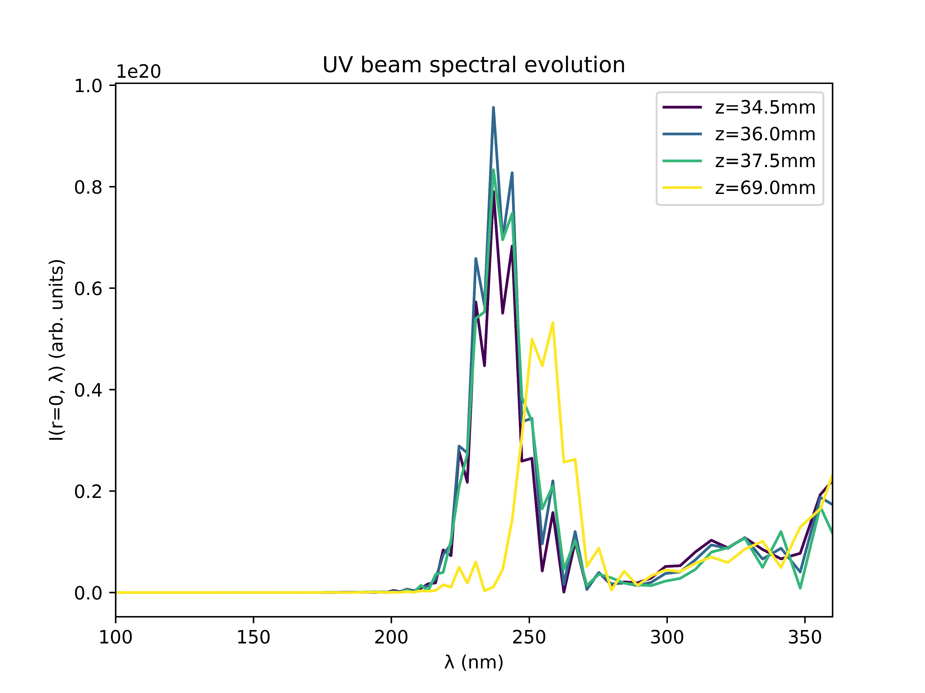
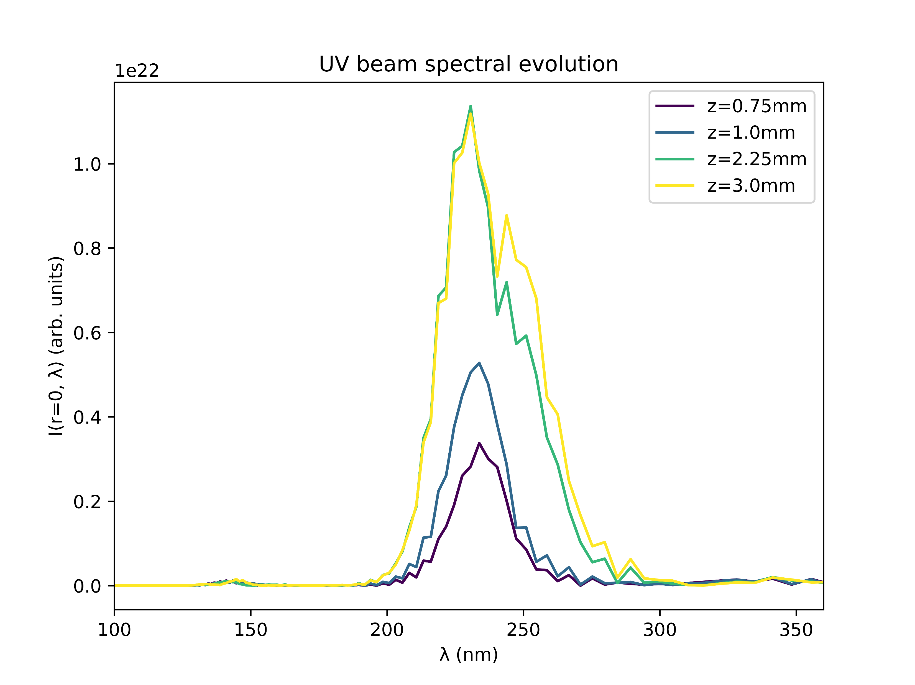
Case study: Argon at 1.0bar with 150mW
COMSOL
gradient

Slide 20
Conclusions
Despite the relatively good agreement of the gradient and COMSOL models within the cell, the simulation output is drastically different
Apart from the scale of the UV output energy, the gradient model seems to produce results that agree more closely with the expected and measured pulse properties
The relevant factor appears to be the propagation of the pulse outside the cell, which is neglected in the gradient model
Compare gradient model to a truncated COMSOL model involving only the cell itself?
Investigate propagation of the pulse before and after the cell? (see next slide)

Slide 21
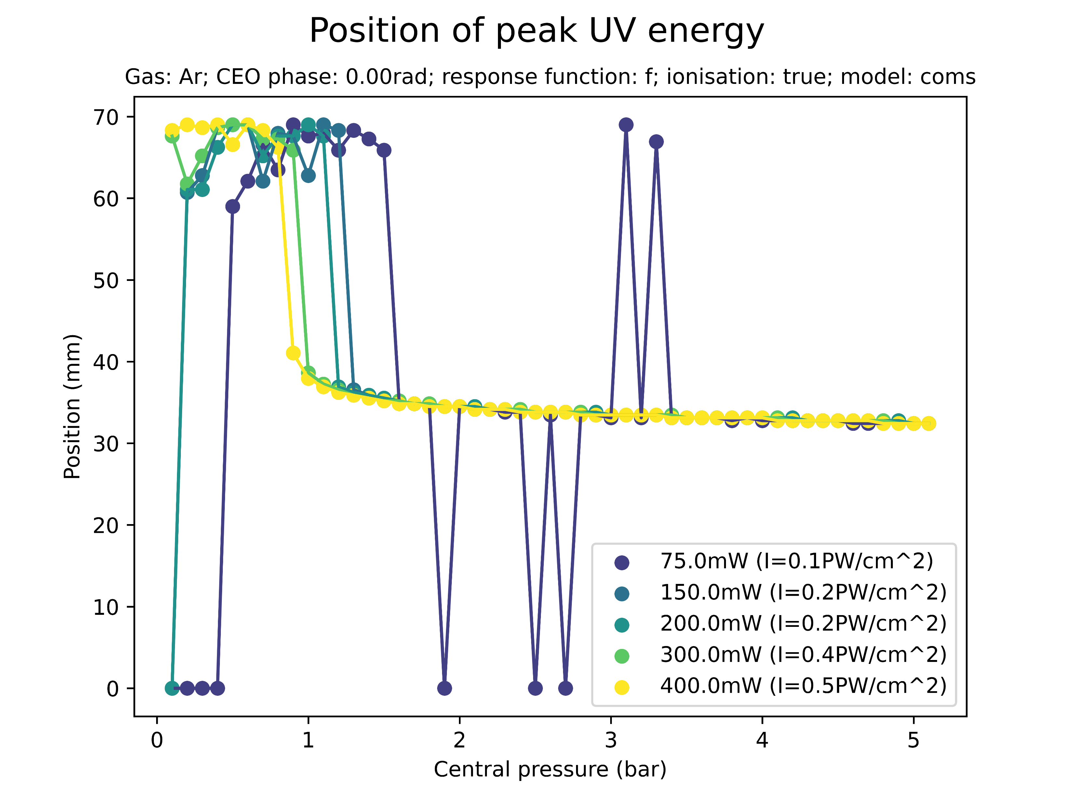
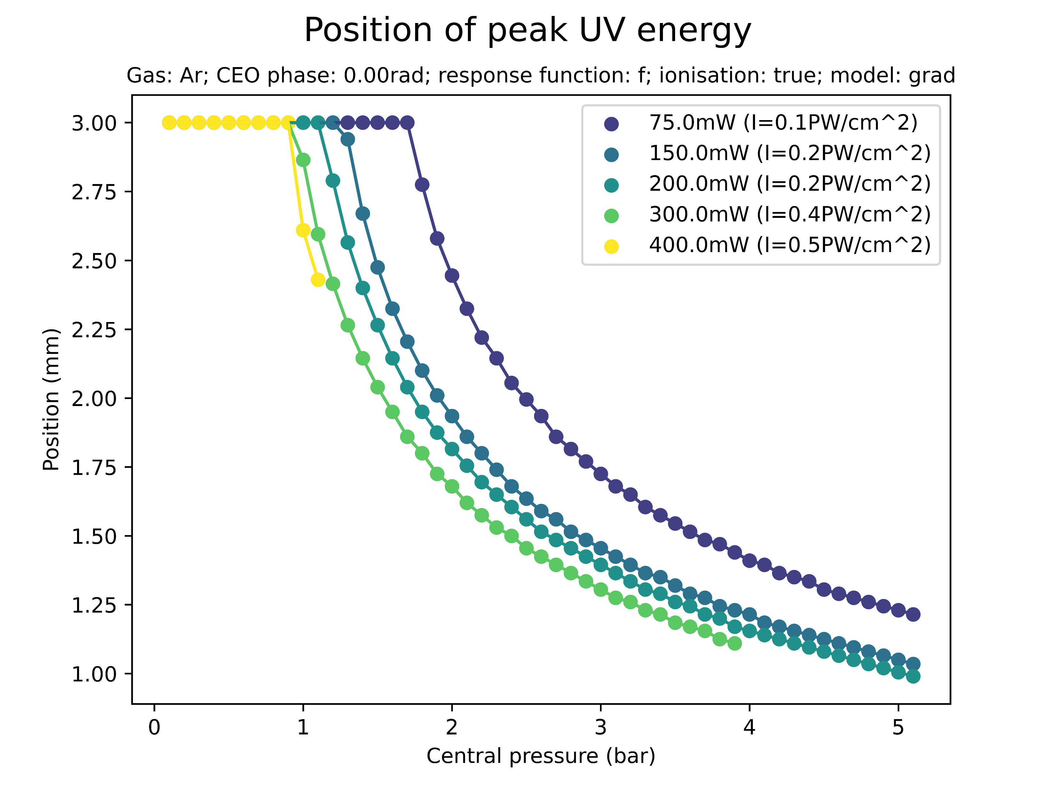
Side note: position of the UV maximum
A possible way to investigate the behaviour outside the cell is to consider where the maximum UV energy is measured
This is probably closely linked to saturation effects

Slide 22
II. GAS COMPARISONS

Slide 23
Energy saturation
The table below indicates whether UV energy saturation sets in at the given pressure range (0.1bar to 5.1bar) powers
Thus, there are four saturable gases (Ar, Kr, N2, N2O) and three non-saturable gases (Ne, He, Xe)
For non-saturable gases: benefit in increasing pressure further!
Beam power | Ar | Ne | He | Kr | Xe | N2 | N2O
75mW | Y | N | N | Y | N? | Y | Y
150mW | Y | N | N | Y | N? | Y | Y
200mW | Y | N | N | Y | N? | Y | Y
300mW | Y | N | N | Y | N? | Y | Y
400mW | Y | N? | N | Y | N? | Y | Y?
Y: yes for both models; N: no for both models; Y/?N?: yes/no for COMSOL, as of yet unknown for grad

Slide 24
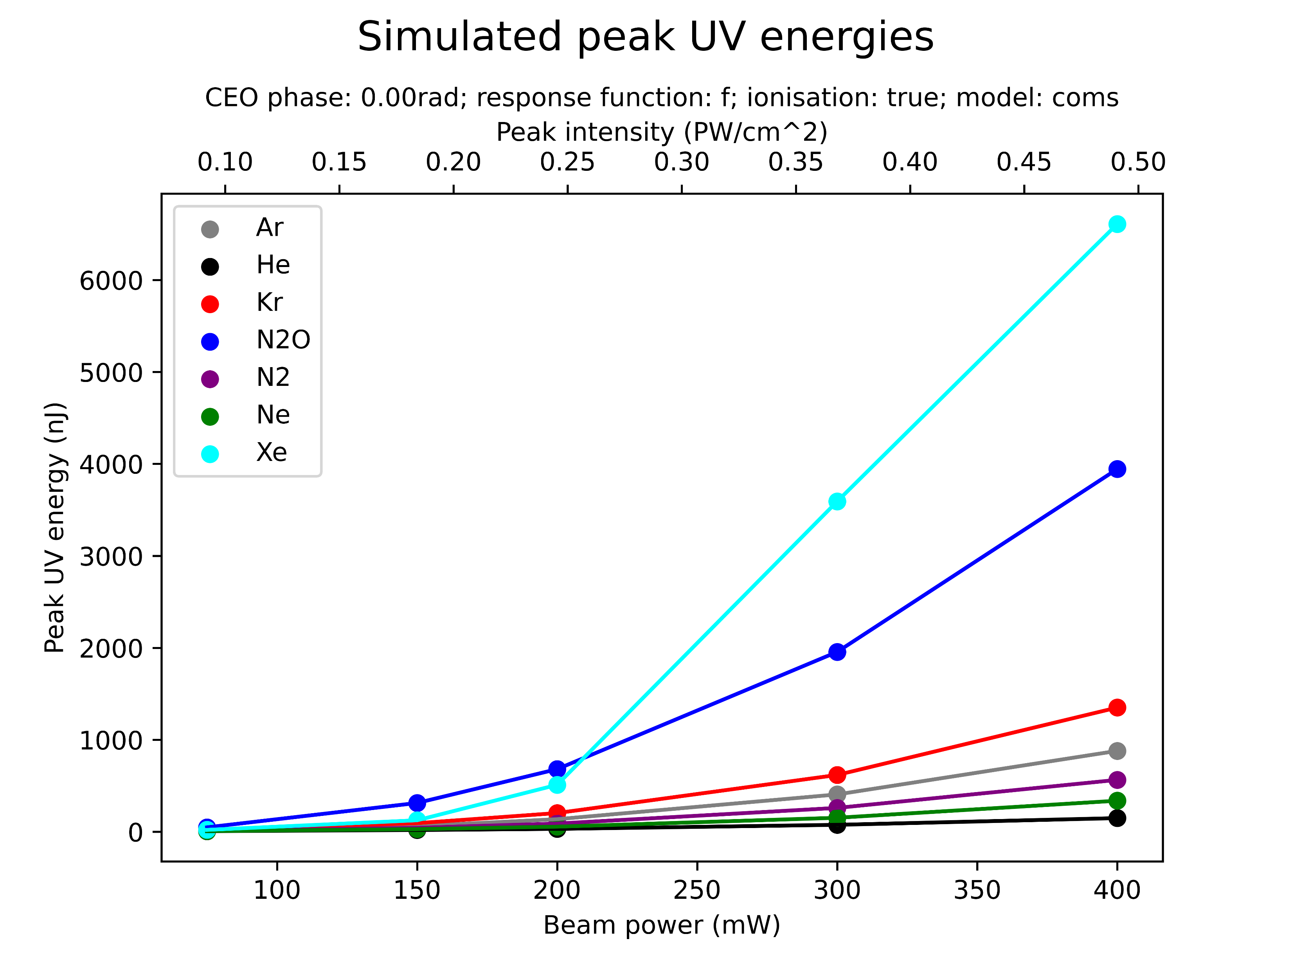
Peak energies
Notes:
due to unfinished scans the energies of the non-saturable gases might be underestimated
the gradient model data is not fully available yet but qualitatively agrees, although at much higher energies
THG in Xe and N2O is significantly more powerful than in the other gases
He and Ne are particularly weak
Peak energies could be further increased by increasing beam power and the central pressure

Slide 25
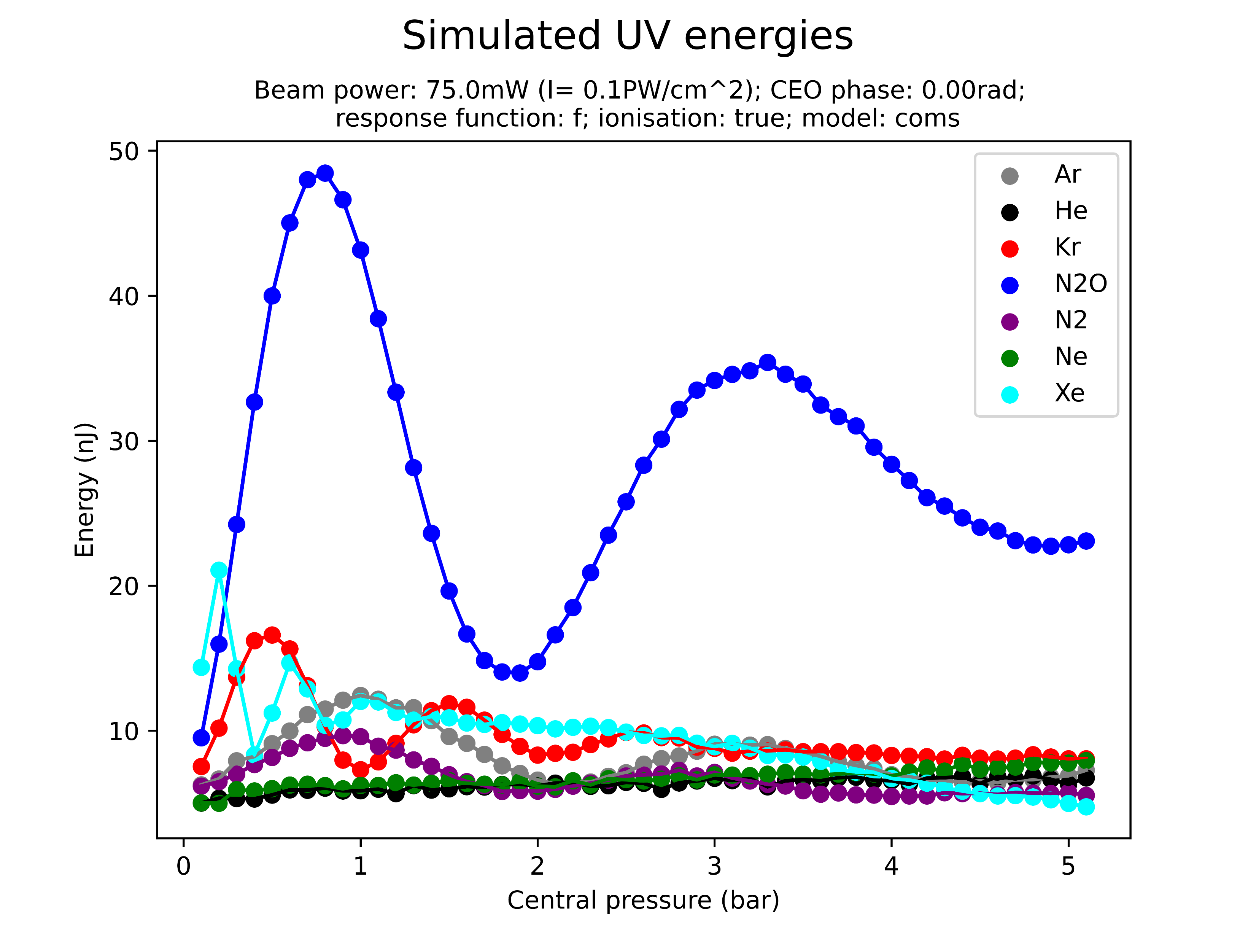
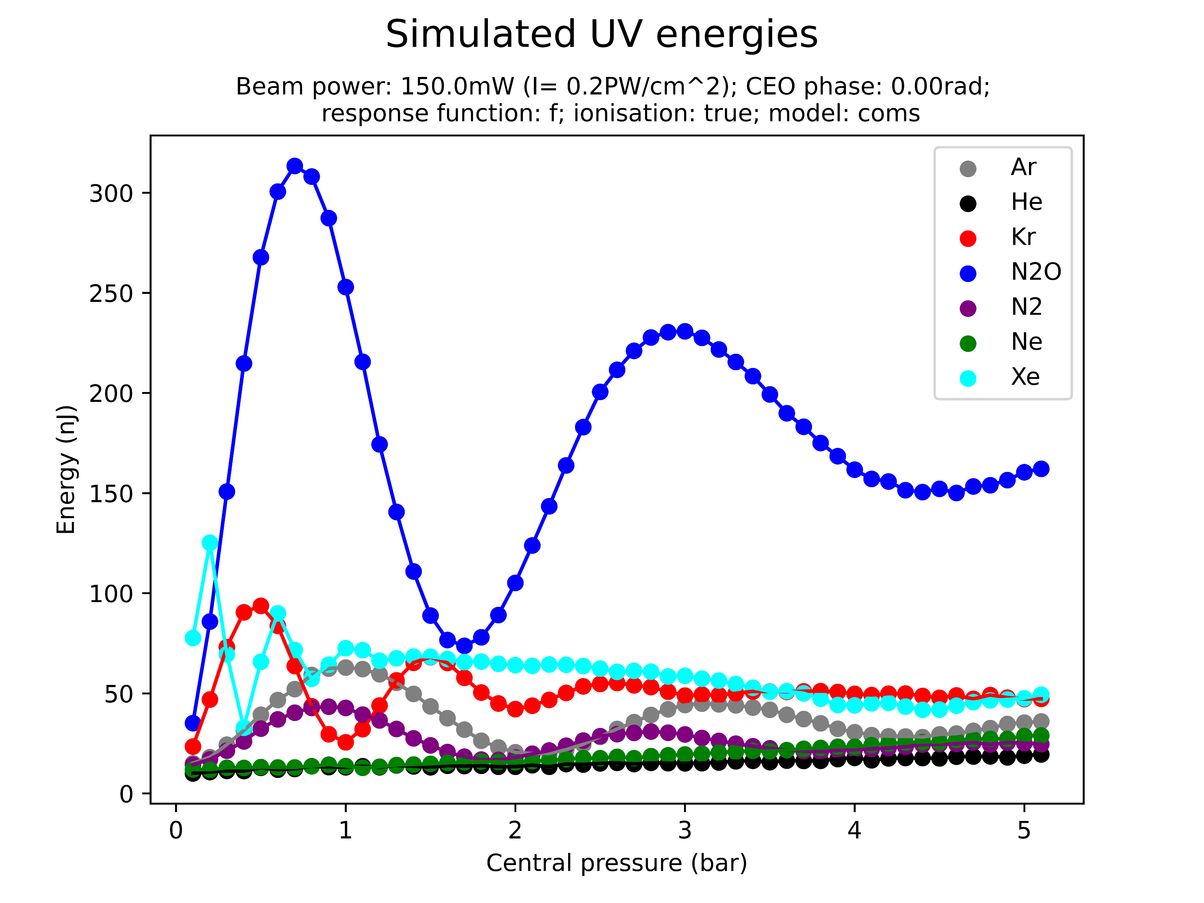
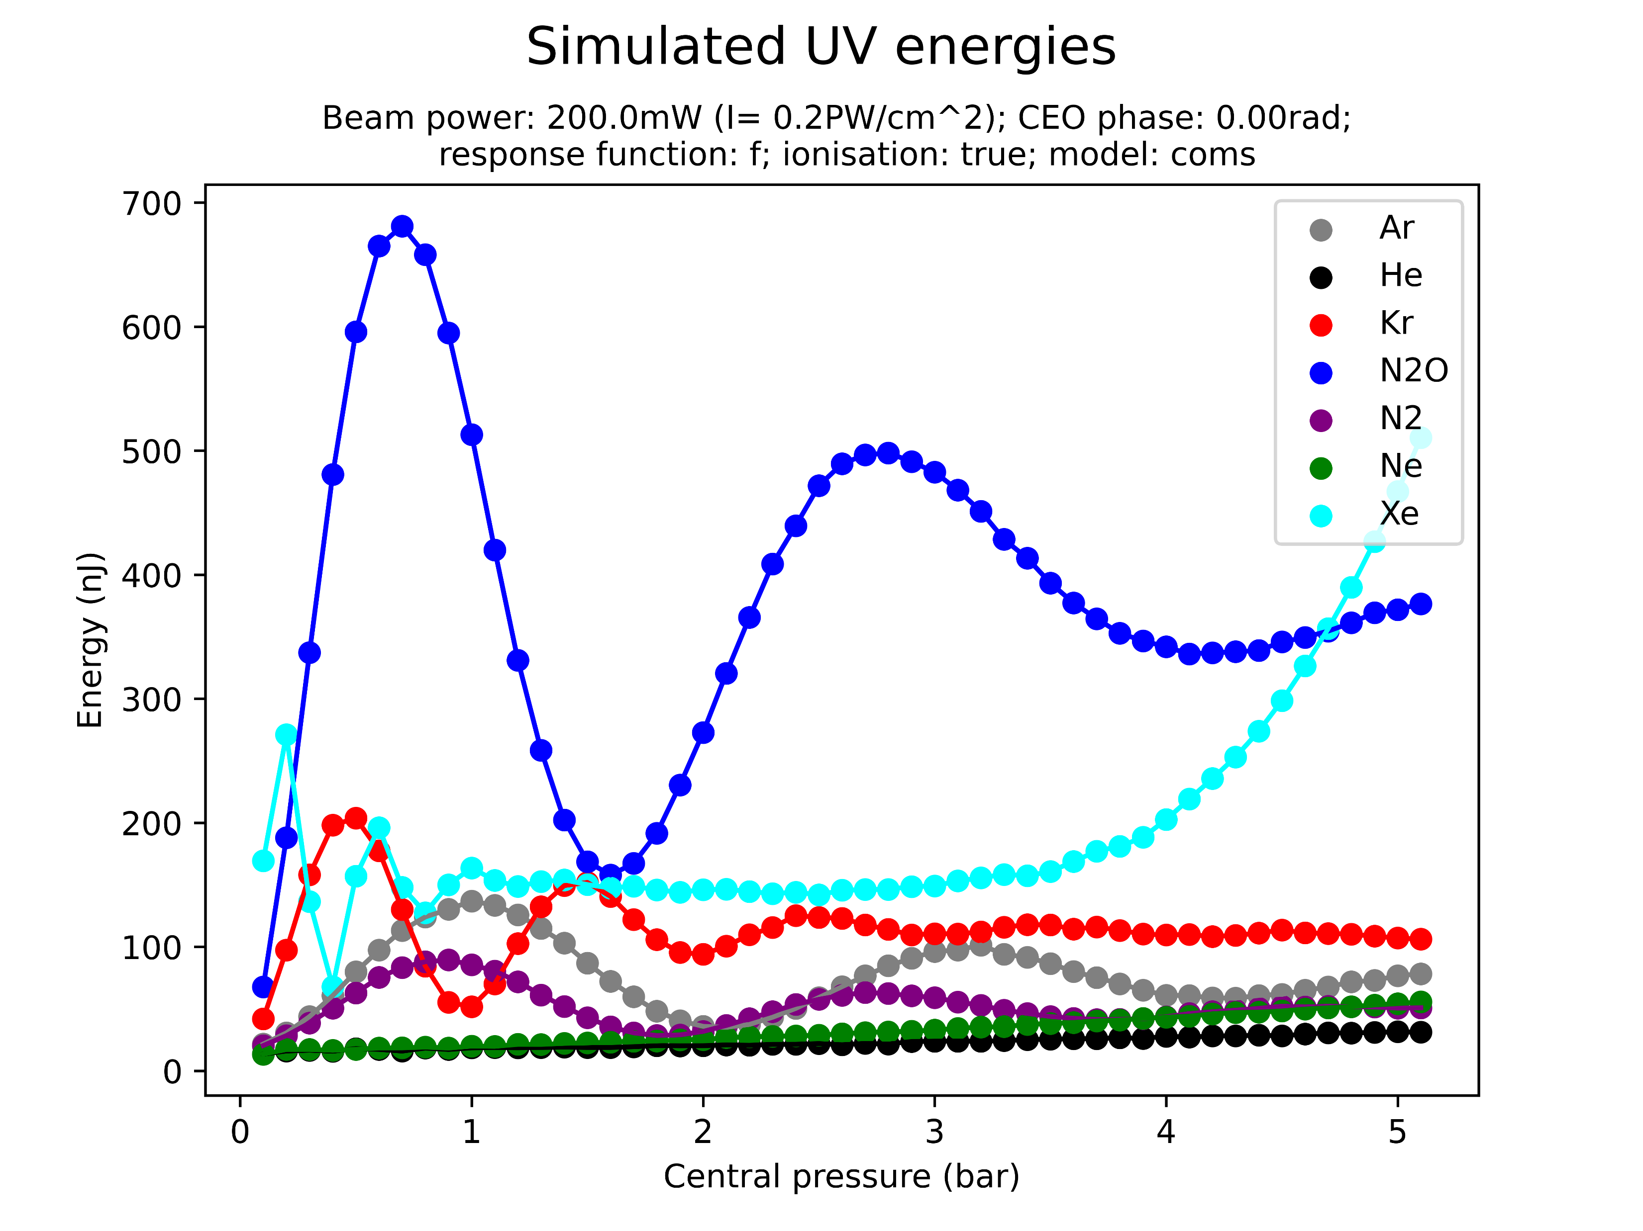
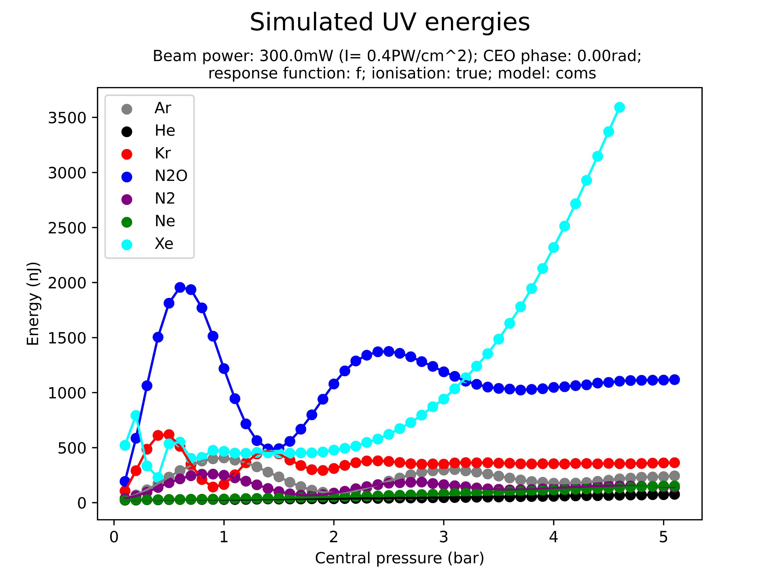
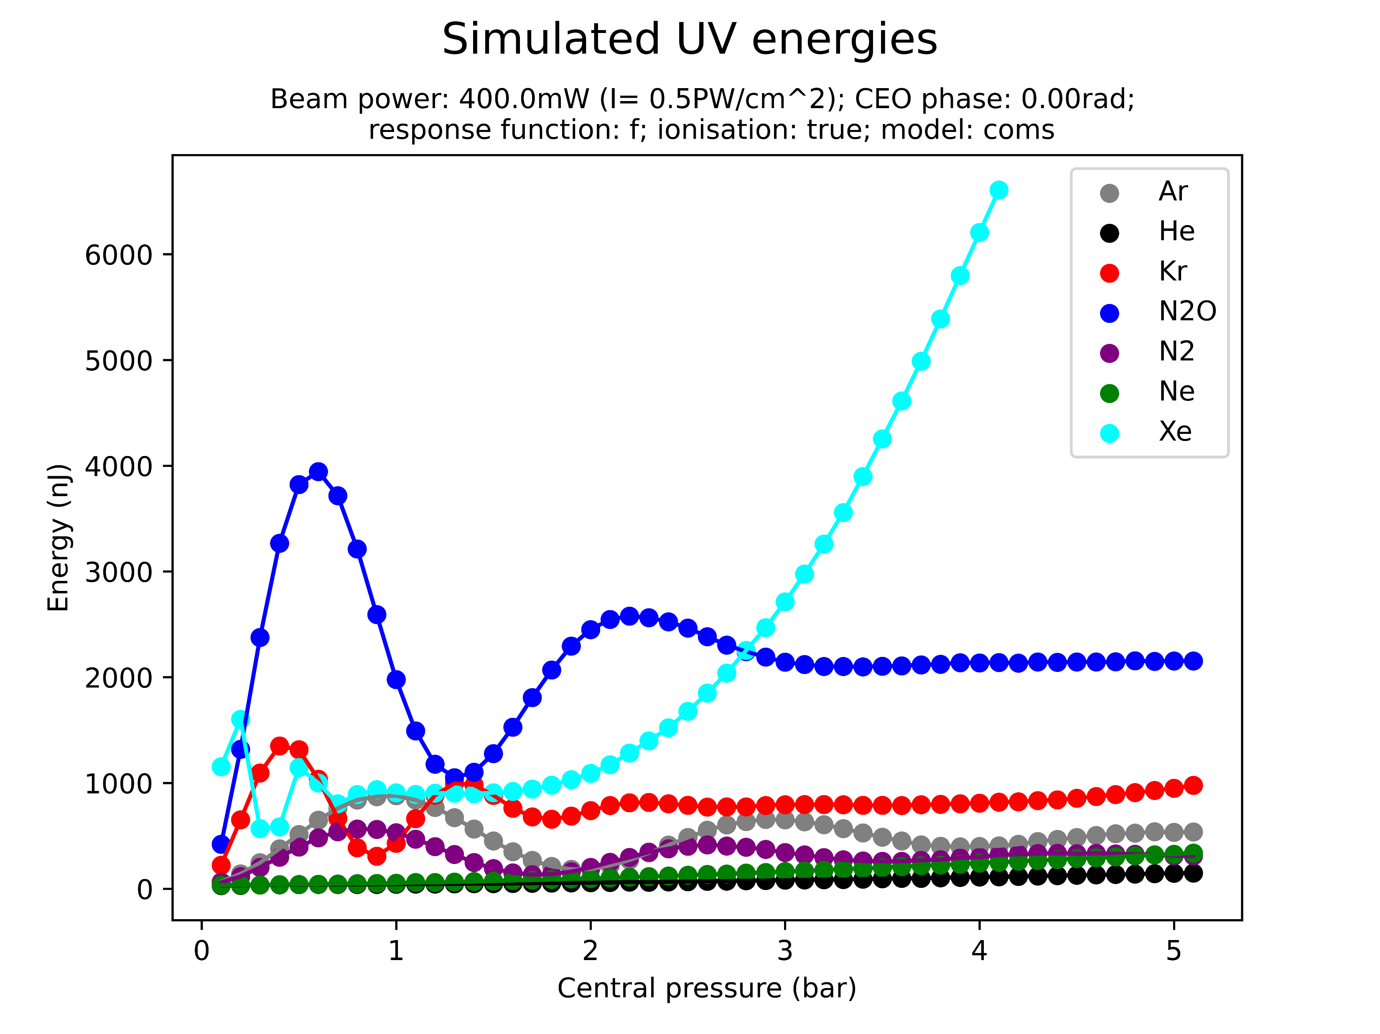
Pulse energies: extra detail
The purpose of these plots is mainly to indicate that the peak energy is a good indicator of the energy across different pressures

Slide 26
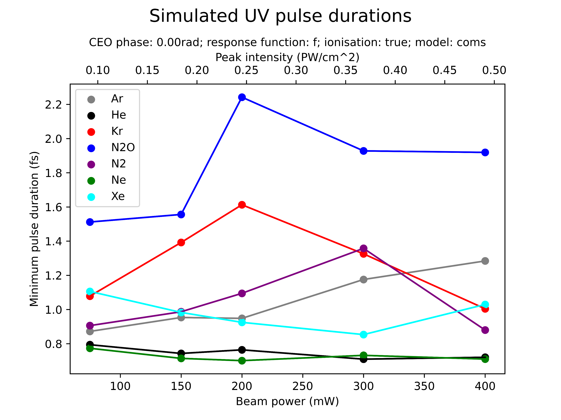
Pulse durations
Notes:
due to unfinished scans some minimal pulse durations might be overestimated
comparable data for the gradient model is still being simulated
this plot could be misleading (see below and next slide)!
There is a clear pattern of He and Ne consistently achieving the shorted pulses across all pressures for different beam powers, with N2, Ar and Kr forming a middle ground and N2O performing the worst
But: the plot shows the minimum pulse duration across all pressures and includes potentially not significant low-energetic UV fluctuations at low pressures

Slide 27
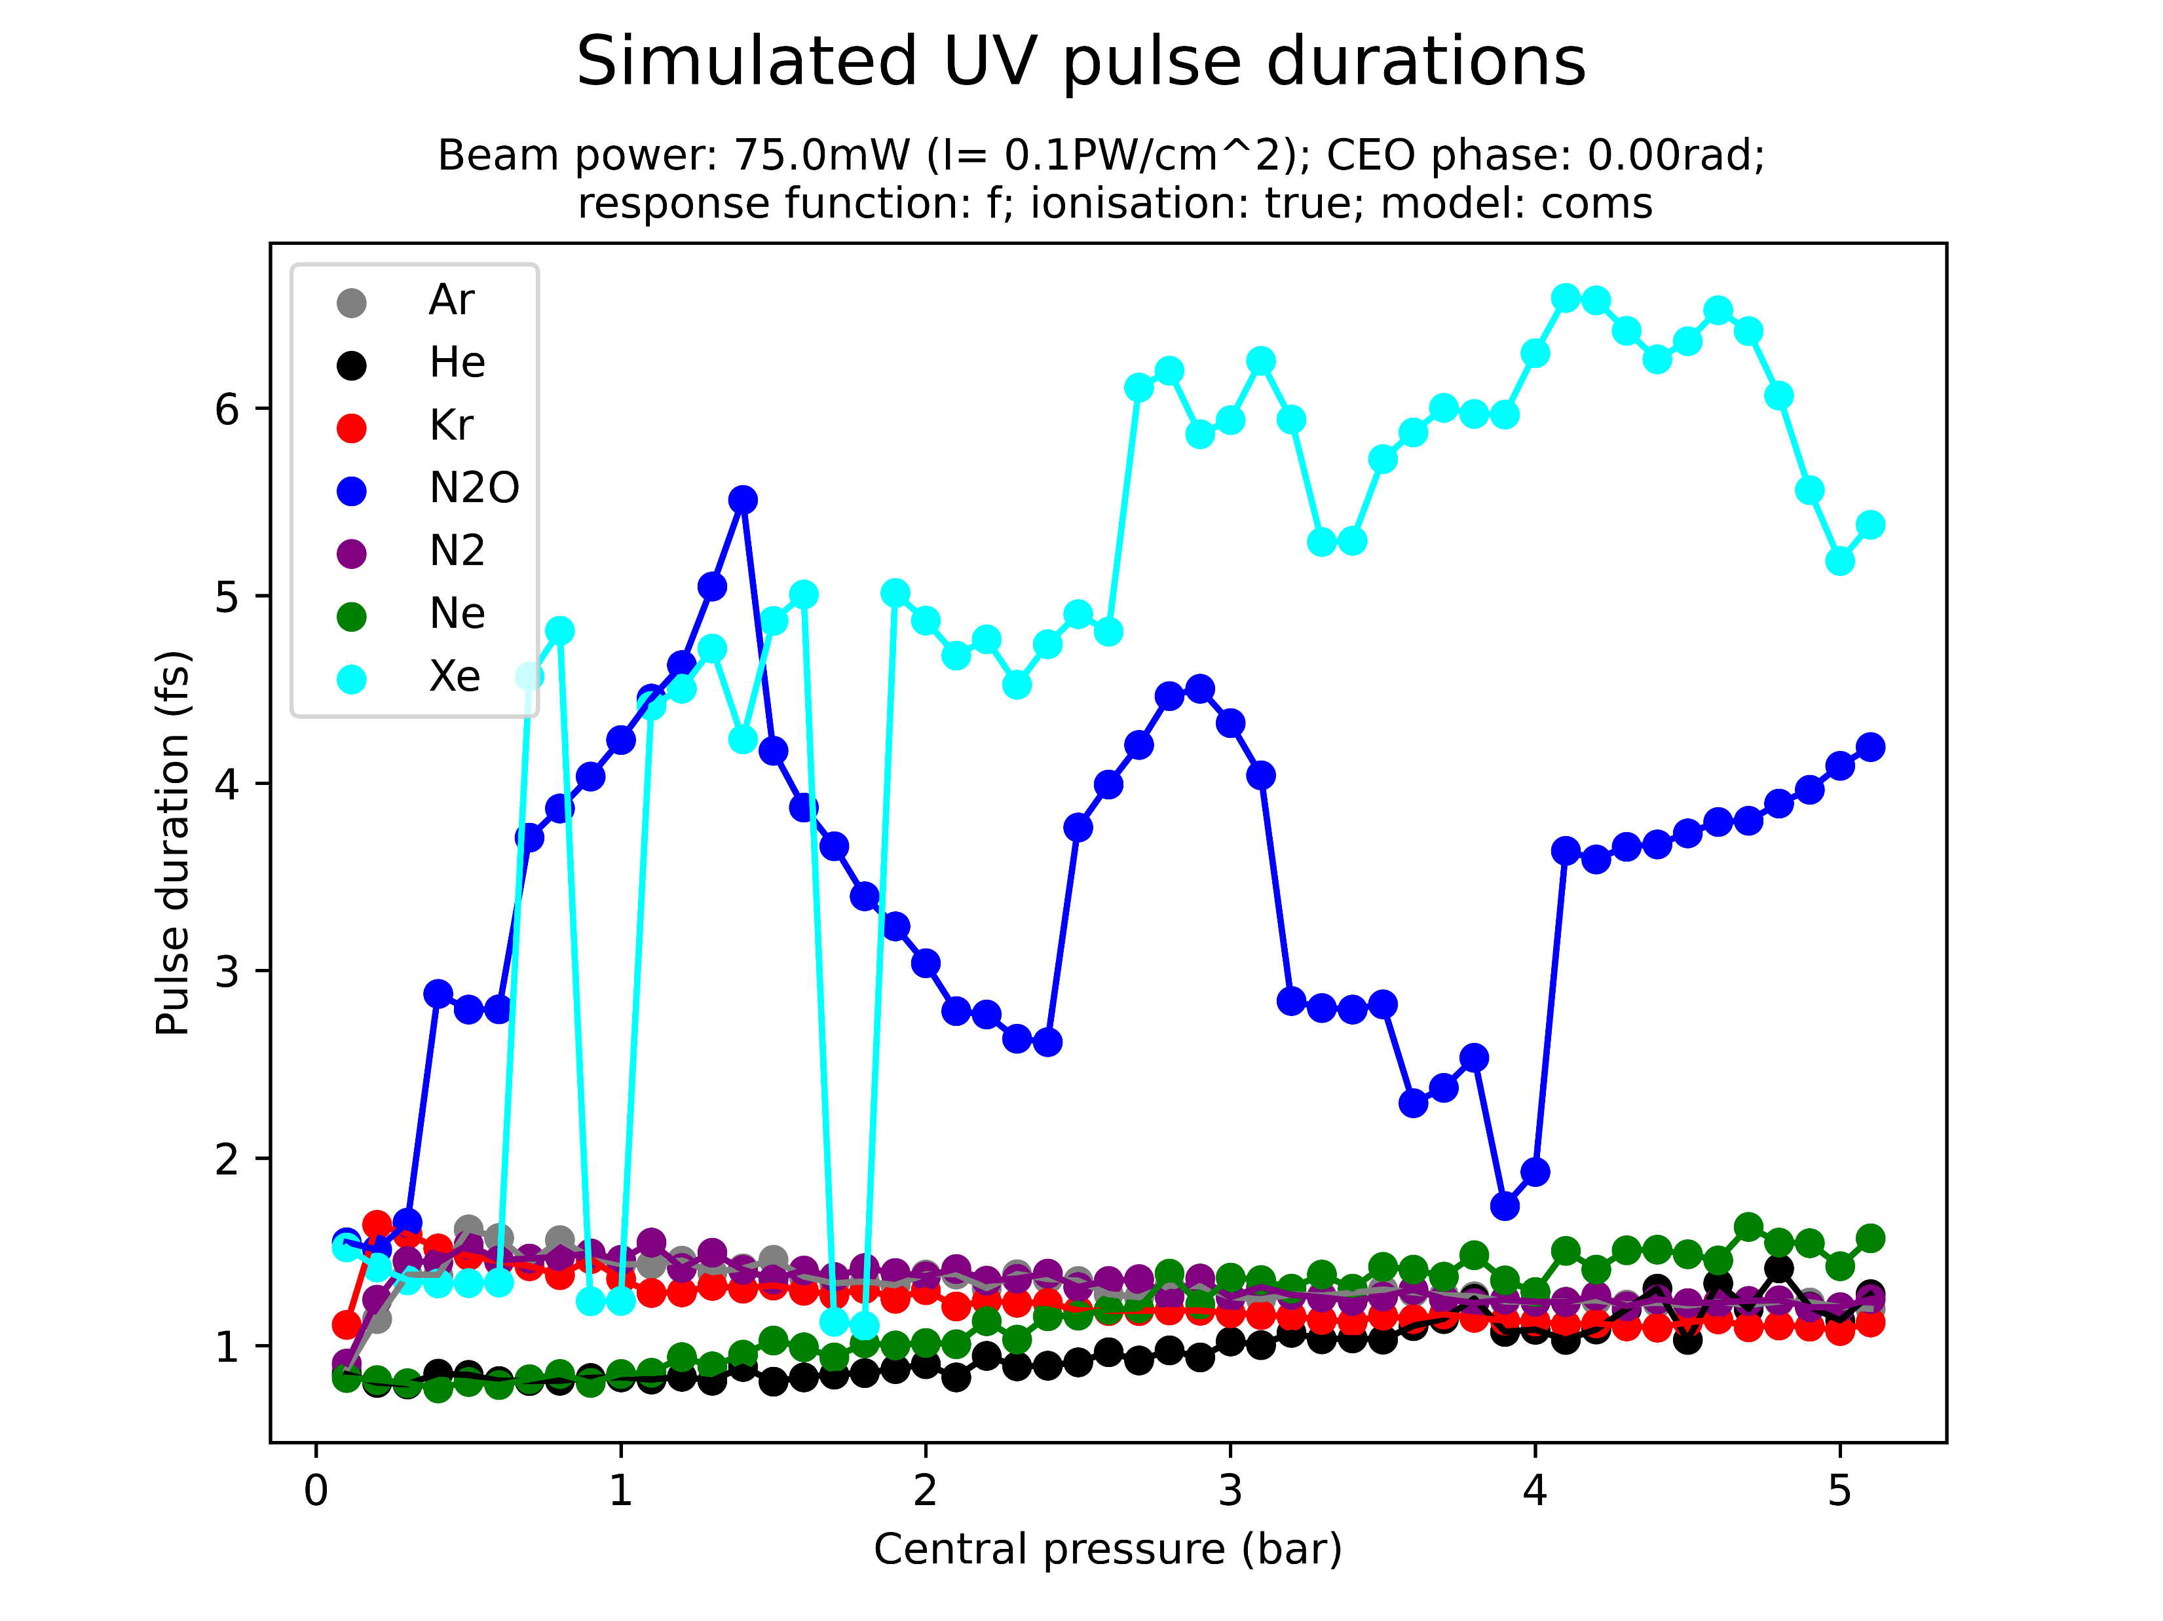
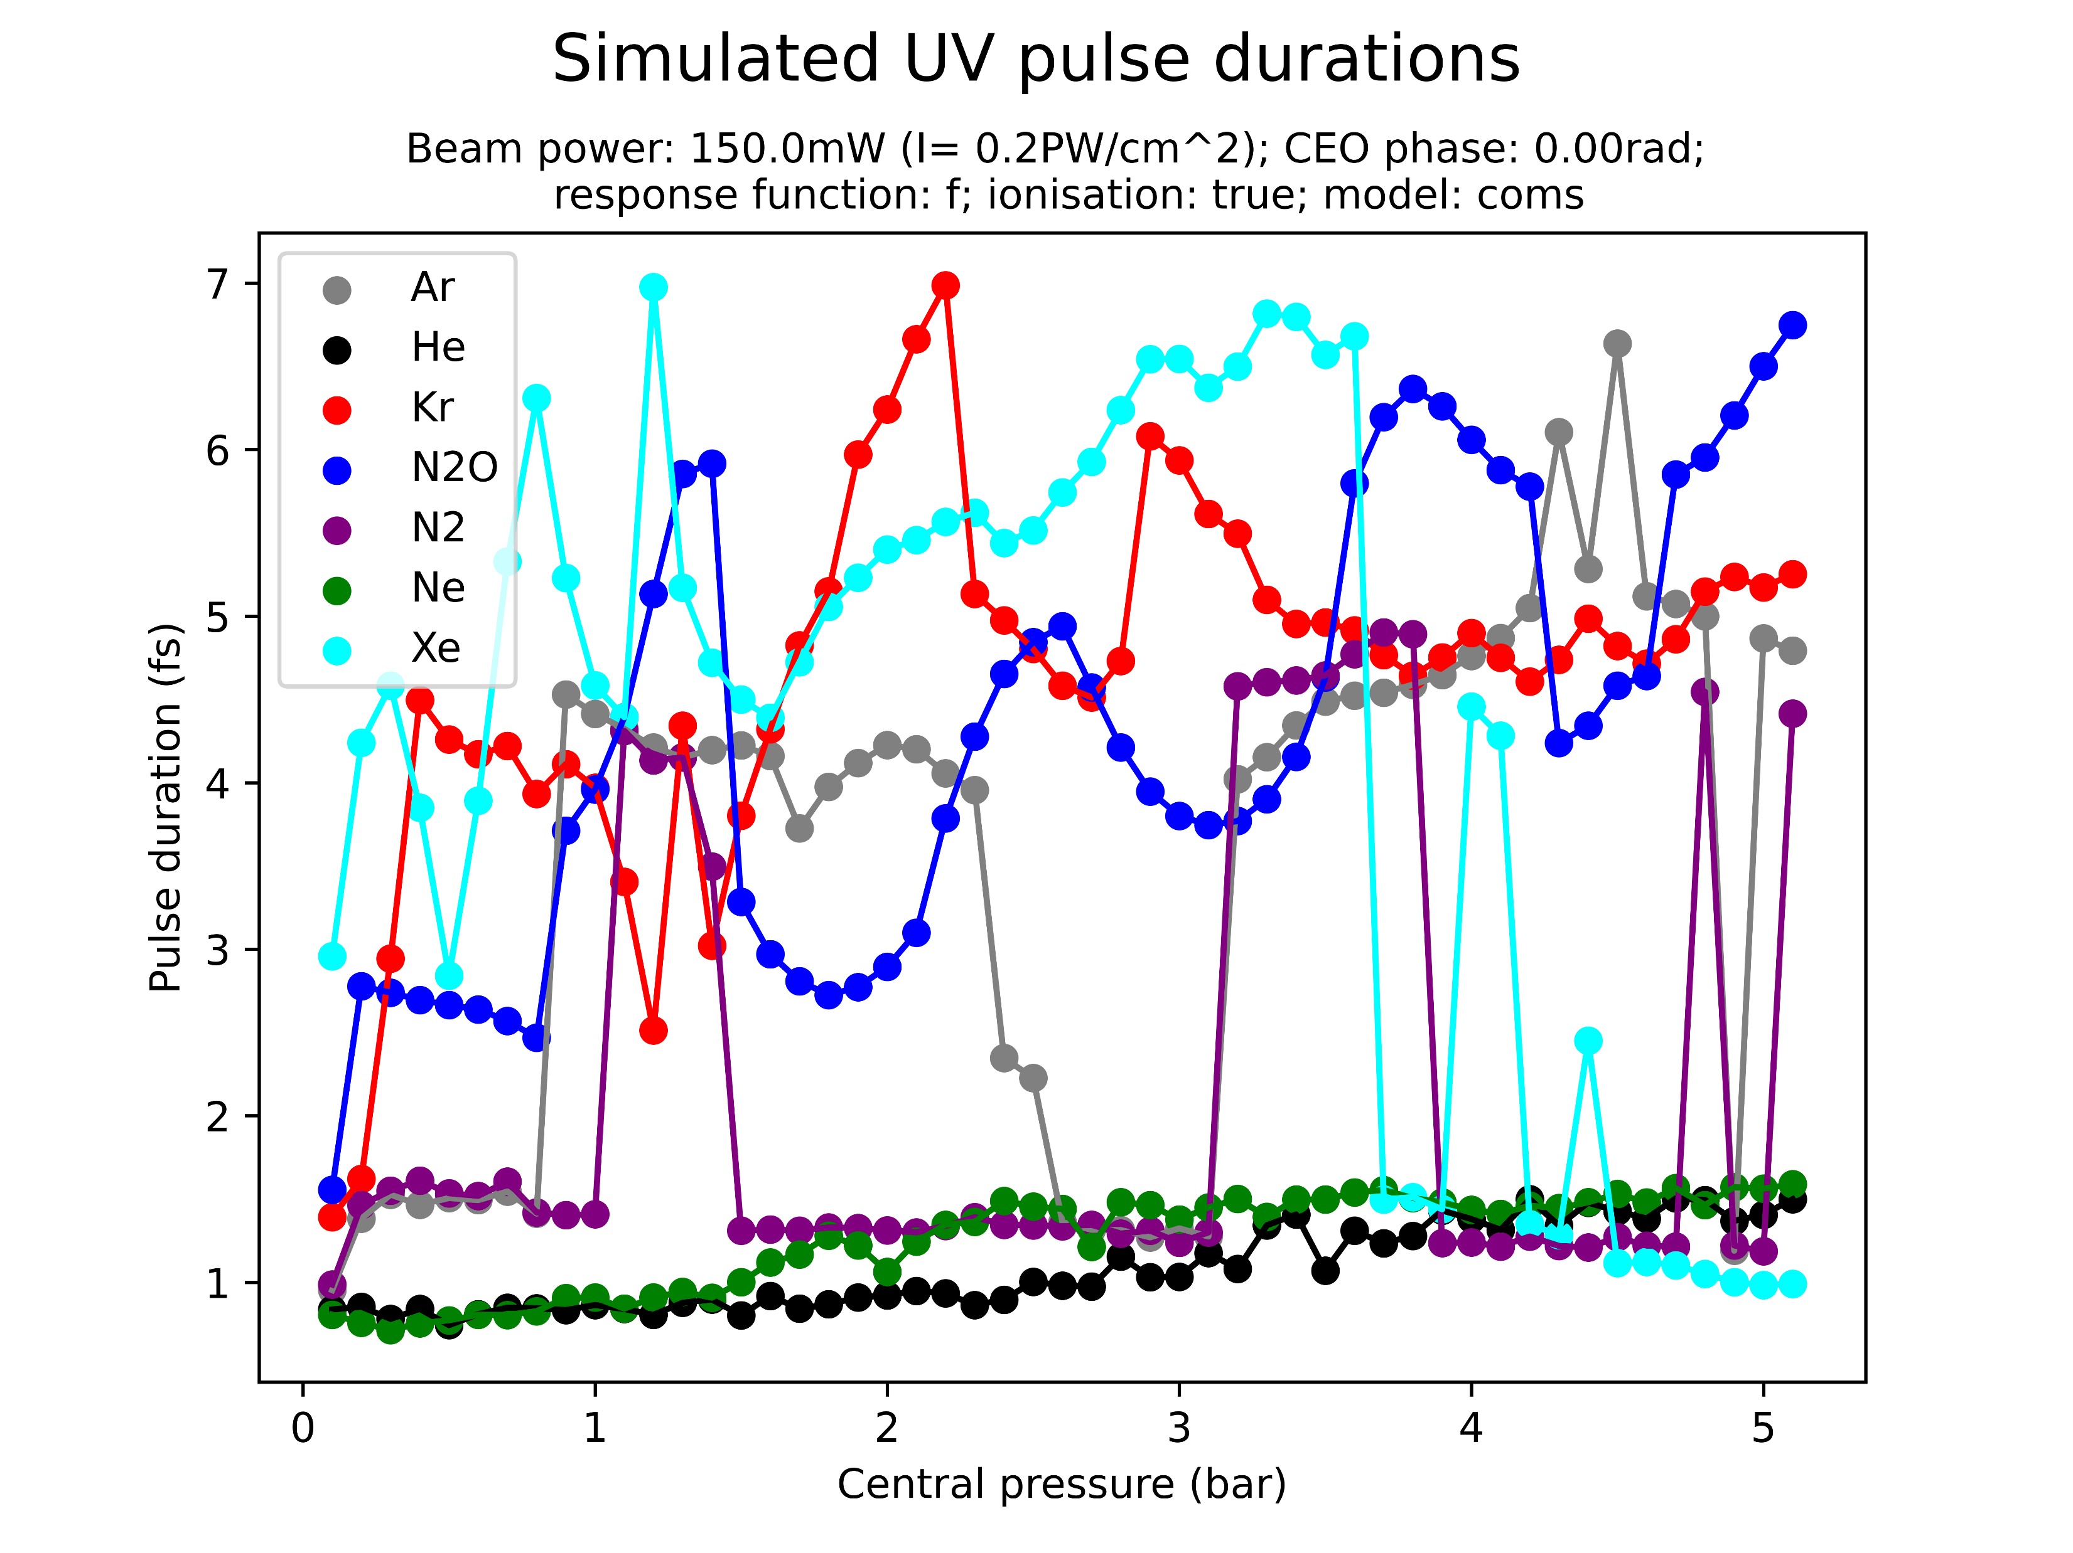
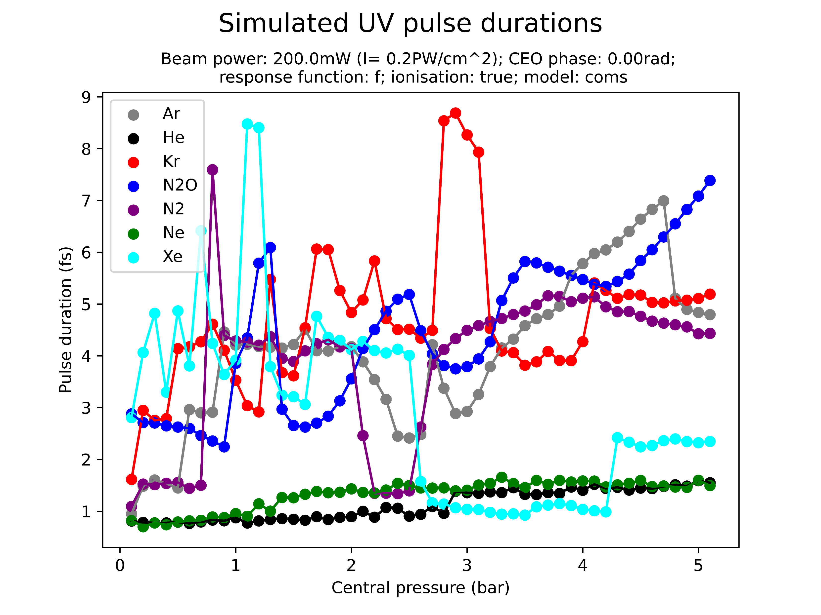
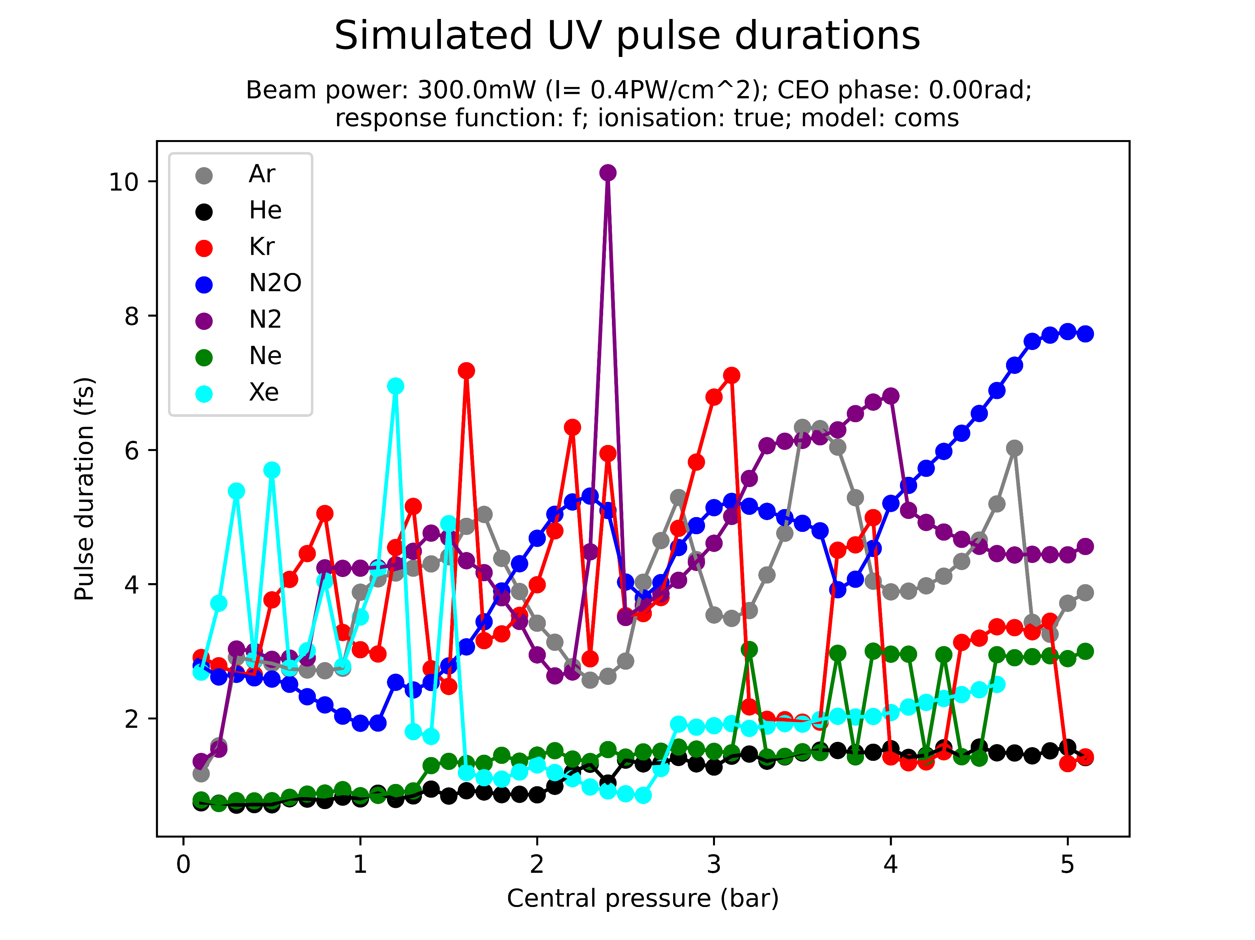
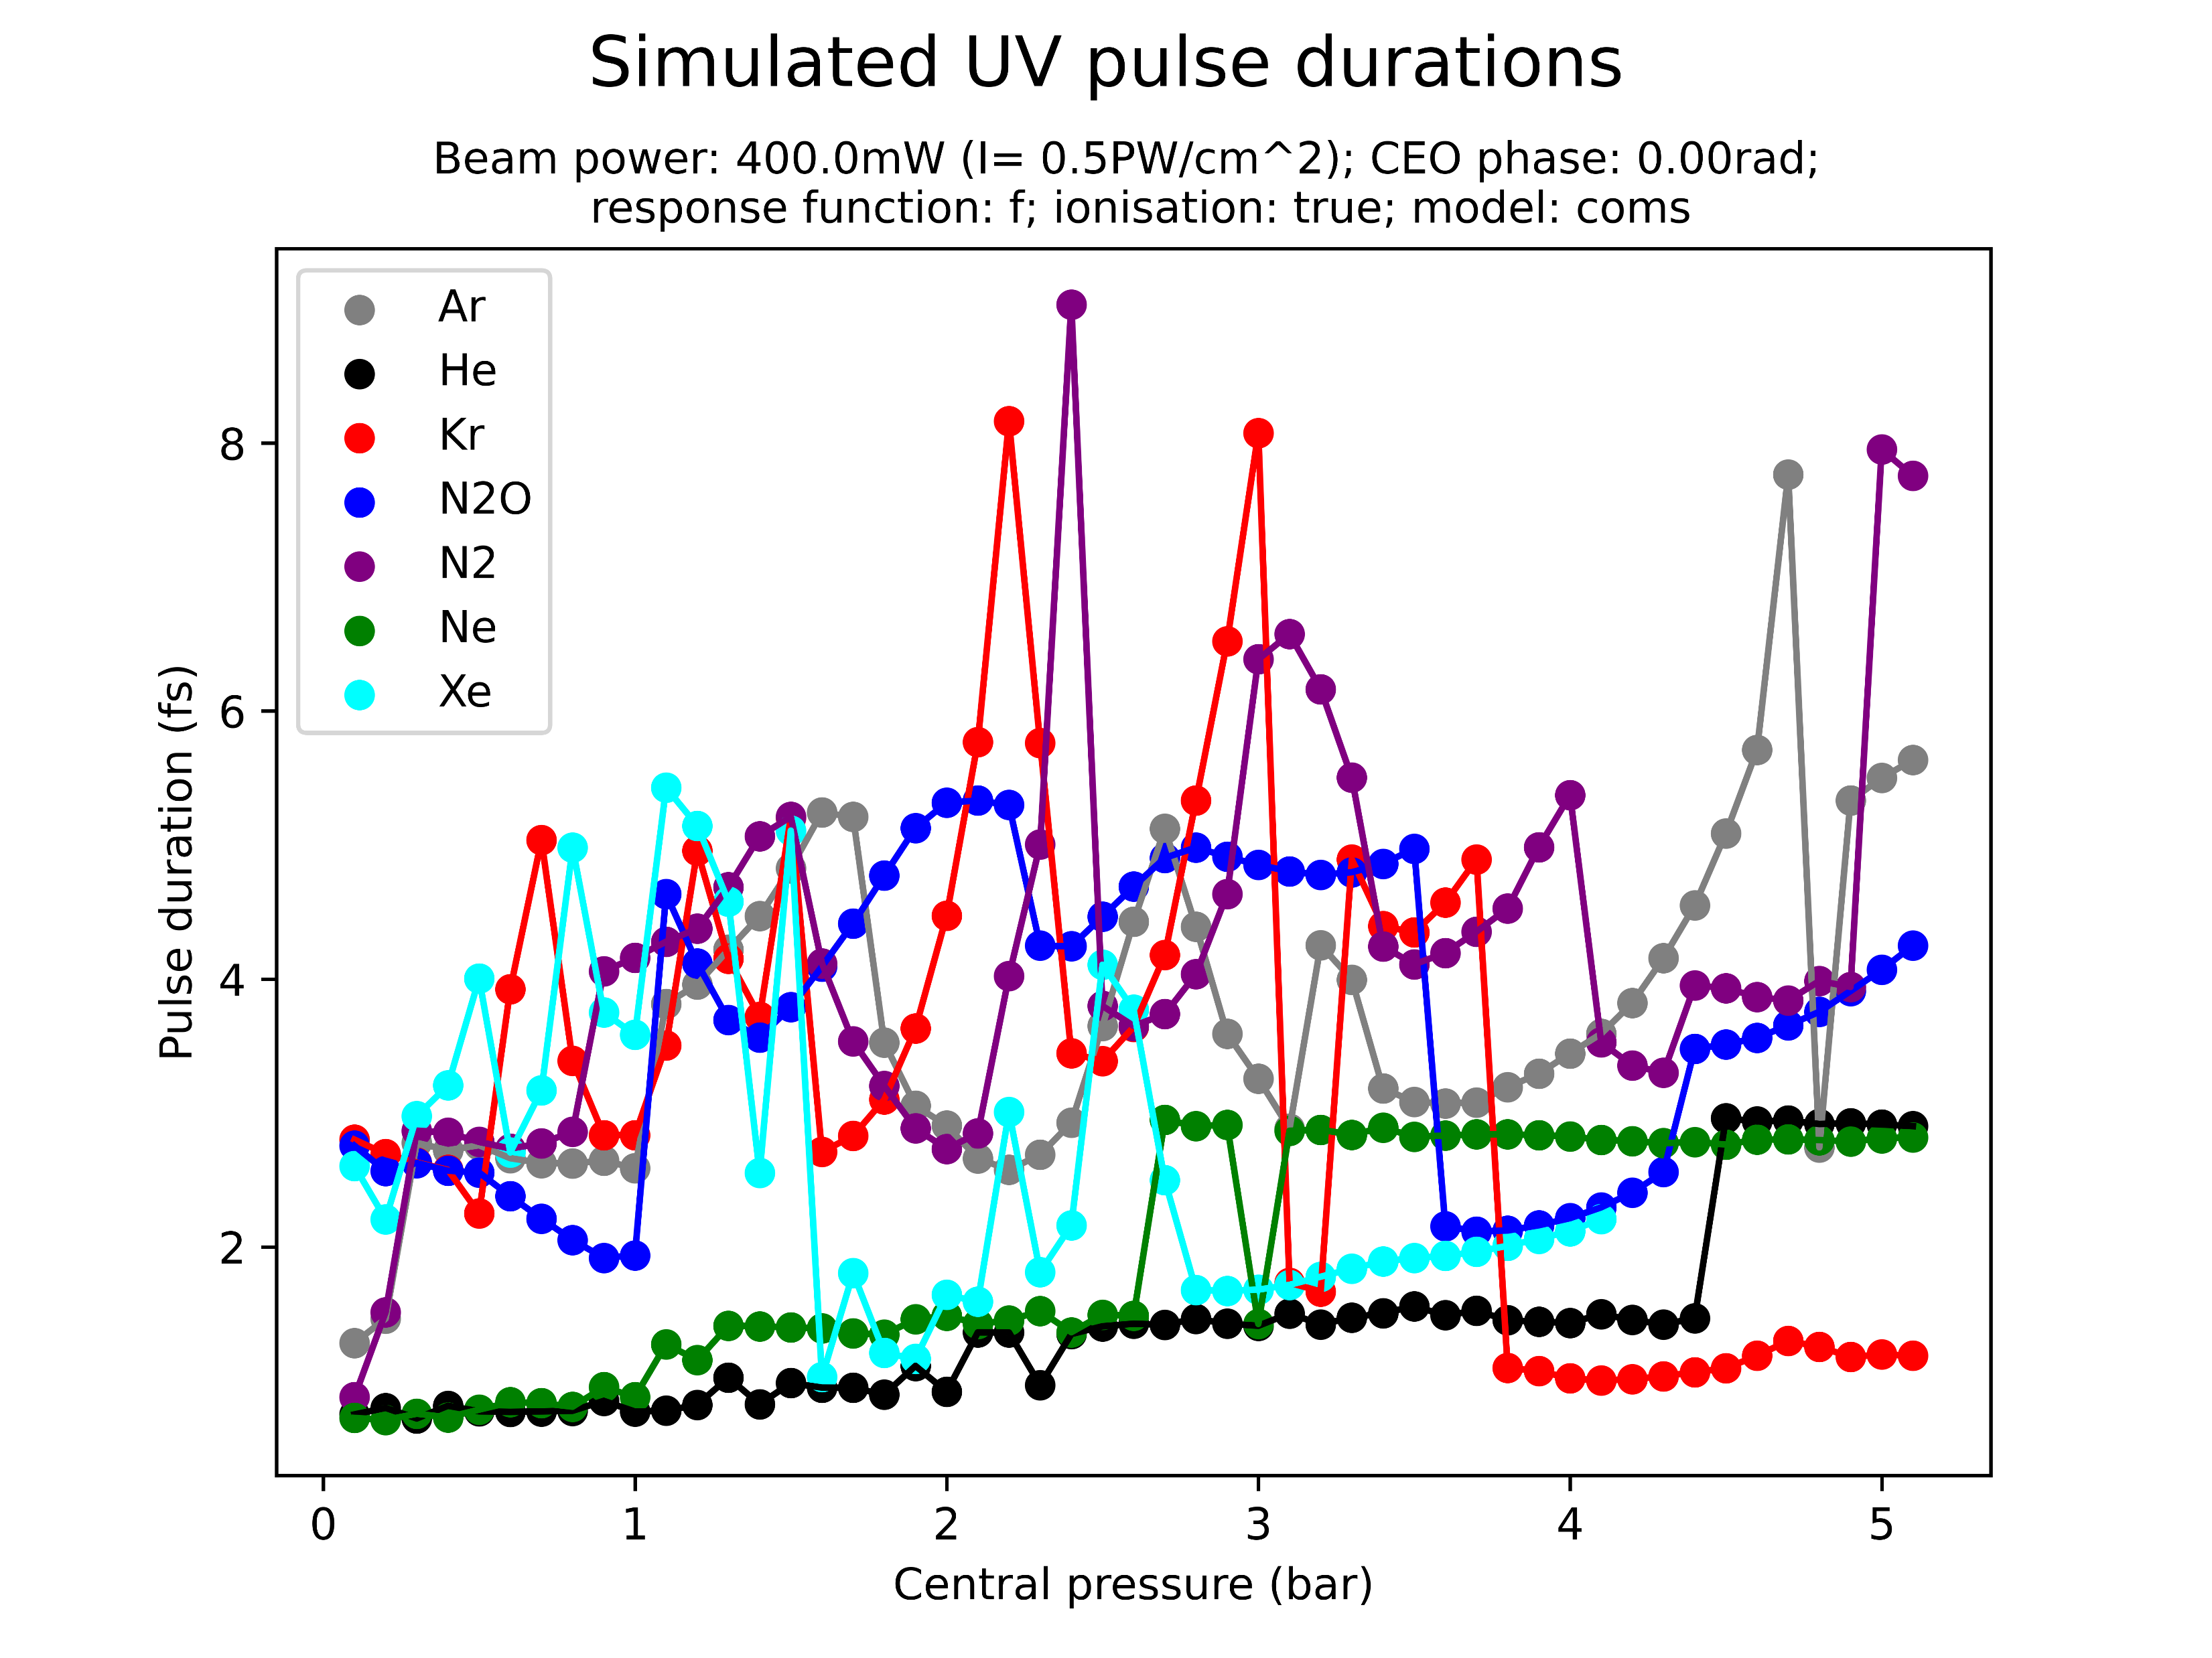
Pulse durations
These plots serve to show that the relationship between pulse duration, pressure, beam power and gases is non-trivial and not captured well by the minimum pulse duration

Slide 28
III. CONDITIONS OF INTEREST

Slide 29
Conditions of interest
The previous section showed the complex relationship between gas type, beam power, gas pressure, pulse duration and pulse energy
From what was seen it is difficult to work out general rules and patterns for ideal THG conditions (short but energetic pulses)
For this reason, a set of promising conditions was identified manually based on the simulation output
Not a very rigorous process! Involved many estimates…
Note that both COMSOL and gradient-based data was considered, although the former rarely predicted suitable conditions

Slide 30
Conditions of interest: table (1/2)
The following table shows parameter combinations which are predicted to result in energetic (>100nJ) and short (sub-2fs) UV pulses
Gas | Beam power | Pressure | Density model | Pred. duration | Pred. energy
Ne | 400mW | 0.1-2.5bar | grad | 0.5-0.8fs | 100-800nJ
He | 400mW | 2.0-4.0bar | grad | 0.8fs | 500-1500nJ
Ar | 300mW | 2.5-4.0bar | grad | 1.1-1.5fs | 800-1000nJ
Xe | 300mW | 1.5-2.5bar | COMSOL | 0.7-1.1fs | 500-700nJ
He | 300mW | 2.0-5.0bar | grad | 0.6-1.0fs | 300-1400nJ
Ar | 300mW | 3.5-4.0bar | grad | 1.2fs | 800nJ
Ne | 300mW | 1.0-5.0bar | grad | 0.7-1.0fs | 500-2500nJ
N2 | 200mW | 3.0-5.0bar | grad | 1.5-1.9fs | 400-450nJ

Slide 31
Conditions of interest: table (2/2)
The following table shows parameter combinations which are predicted to result in energetic (>100nJ) and short (sub-2fs) UV pulses
Gas | Beam power | Pressure | Density model | Pred. duration | Pred. energy
N2O | 200mW | 3.5-5.0bar | grad | 1.1-1.3fs | 700-900nJ
Kr | 200mW | 1.5-3.0bar | grad | 1.3-1.5fs | 500-600nJ
He | 200mW | 3.0-5.0bar | grad | 0.5-1.1fs | 200-450nJ
Xe | 150mW | 0.8-2.0bar | grad | 1.5-1.9fs | 300-500nJ
N2O | 150mW | 3.5-5.0bar | grad | 0.8-1.3fs | 600-800nJ
Kr | 150mW | 1.5-2.5bar | grad | 1.3-1.5fs | 400-500nJ
He | 150mW | 4.5-5.0bar | grad | 1.1-1.2fs | 130-200nJ
N2 | 150mW | 4.0-5.0bar | grad | 1.6-1.9fs | 400-450nJ
Ne | 150mW | 2.1-5.0bar | grad | 0.7-1.1fs | 150-500nJ

Slide 32
IV. NEXT STEPS

Slide 33
Next steps?
Investigate some “conditions of interest” in more detail?
Ideally could find something useful or make predictions for next week’s experiments?
Implement beam chirp and carry out chirp scan?
Investigate the effects of parameters like the beam waist and beam focus?
Analyse the scan data in more detail and with the full data?
Compare spectra?!
Run scans with the PPT ionisation model instead?
Investigate effect of pulse propagation outside the cell?

